Slide 1
Rock Hill Economic
Development Corporation
Board of Directors
Monthly Meeting
Tuesday
August 4, 2020
12 noon

Slide 2
Prior Meeting Minutes
  Consider the minutes from the June 2, 2020
  monthly meeting
  E-mailed to the Board on July 31, 2020
  Request for a motion to approve

Slide 3
Executive
Council
Dawn Johnson
RHEDC Chair

Slide 4
Actions from the July 14th Meeting
  A motion was presented from the Finance Committee to approve the May 31, 2020 Financial Reports.
  A motion was presented from the Finance Committee to approve a Change Order from Bohler Engineering for engineering and design services at Aspen Business Park. The change order was for $102,450 and RHEDC’s share of the costs is limited to 36%, based on the agreement with Childress Klein to share in infrastructure costs for Phase I.
  A motion was presented from the Finance Committee to approve the Purchase and Sale Agreement for sale of the Annex Site (167 Lee Street) to a development group known as 167 Lee St, LLC (includes RHEDC board member Justin Smith).

Slide 5
Actions from the July 14th Meeting
  A motion was presented from the Finance Committee to recommend RHEDC accept the 2020-2021 United Way grant for $15,000 as awarded. The grant will support internships and workforce development initiatives through the Talent Pipeline program.
  A motion was presented from the Finance Committee to recommend approval of RHEDC’s application to the NEA for a 2021 Grants for Art Projects. If awarded, the grant will support the addition of a new downtown mural through the Quality of Life’s Mural Mile Project.

Slide 6
Actions from the July 14th Meeting
  The Executive Council approved a motion to form a single asset or development entity (named Village at Osceola, LLC) with Housing Development Corporation of Rock Hill, for the purpose of owning and facilitating the development of the Villages at Osceola project and other matters related thereto. The motion includes the condition that Stephen Turner, as Executive Director of the Rock Hill Economic Development Corporation (RHEDC) or Dawn Johnson, as Chair of the Board of Directors of RHEDC, will act on behalf of the new entity as to all matters requiring approval and execution by RHEDC as a co-shareholder (or owner) of the new entity. Such matters would include, but are not limited to incorporation documents, tax filings, corporate documents, closing documents, grant applications, Articles of Incorporation, regulatory filings, certifications, by-laws, agreements, deeds, mortgages, contracts, sales documents covenants, restrictions and all other matters whatsoever without the necessity of further approval by this Board. Stephen Turner or Dawn Johnson shall also be entitled to execute in the name of and on behalf of RHEDC and the RHEDC board any and all formal resolutions related to this approval.

Slide 7
Quality of Life
Committee
Melanie Jones
Committee Chair

Slide 8
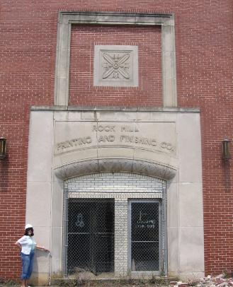

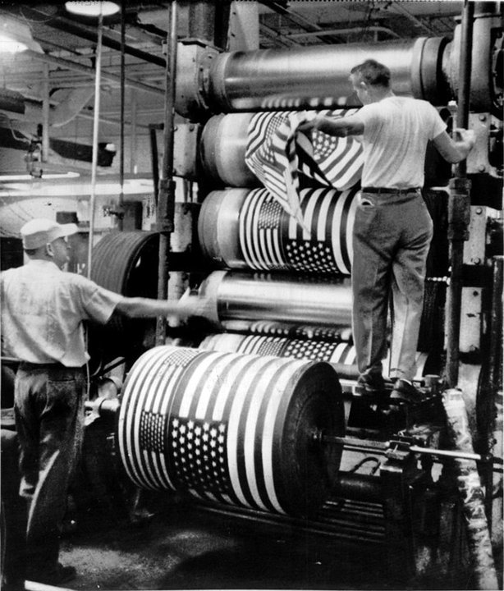
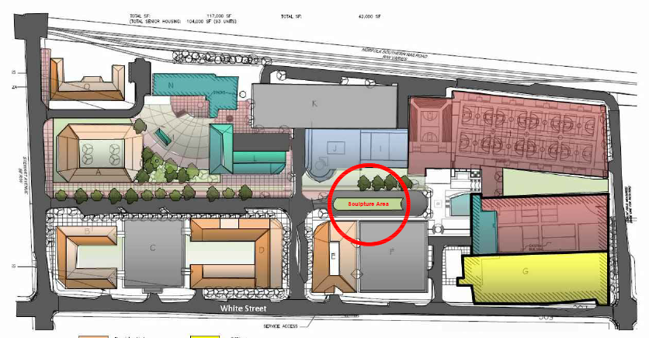
Bleachery Heritage Project

Slide 9
Bleachery Heritage Project
Artist Selection Committee
Sally Baker
Tim Elliott
Kimberly Faust
Debra Heintz
Laurie Helms
Kirk Irwin
Chris Lange
Donnie Messer
Betty Plumb
Emile Russett
Stephen Turner
Gary Williams

Slide 10
Finance
Committee
Matt Dosch
Committee Chair

Slide 11

Rock Hill Economic
Development Corporation
2019 Report to Board of Directors
August 4, 2020

Slide 12

RHEDC
Agenda
Required Auditor Communications
Summary of Financial Statements
Questions and Comments

Slide 13
RHEDC
Required Auditor Communications
Unmodified opinion rendered on financial statements
Planned scope and timing of audit
“One” change in accounting policies
Accounting estimates appear reasonable
No internal control communications
Audit adjustments – none
Passed adjustments – one on consolidating, one on interest
No disagreements with management
No consultations with other independent accountants
No significant difficulties encountered
Full cooperation from all personnel

Slide 14
RHEDC
Summary of Financial Position

Slide 15
RHEDC
Summary of Financial Position

Slide 16
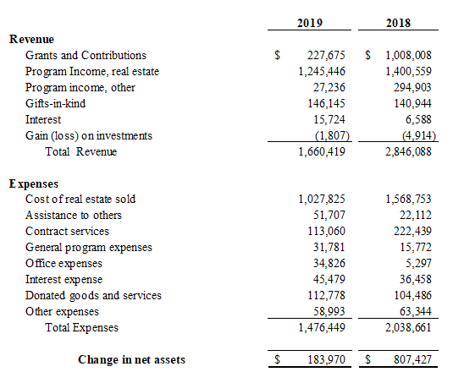
RHEDC
Summary Statement of Activities

Slide 17
Questions and Comments

Slide 18
2019 Audit
  Motion from the Finance Committee to approve the 2019 Audited Financial Statements.

Slide 19


  E-mailed to the Board
  Finance Committee reviewed at July 30th meeting

Slide 20
  Primary income included:
  accrued reimbursements for operating costs and Aspen engineering; interest income
  Primary expenses included:
  activities for Aspen; payment to the City for shared VMS support; legal and accounting fees; insurance; annual meeting costs; and interest expense
  Motion from the Finance Committee to approve Financial Reports from June 2020

Slide 21
Financial Management Plan
  The Financial Management Plan provides goals for achieving financial sustainability, including guidelines for the investment of RHEDC’s limited resources.
  Adopted in 2014 and last revised in 2015
  An annual report of the plan is reviewed each year during budget planning
  Finance has reviewed the plan and recommends two updates to ensure the plan aligns with RHEDC’s current strategic goals and financial position:
  Revision 1: An updated goal to increase RHEDC’s net assets from $4 million by 2018 to $6 million by 2024

Slide 22
Financial Management Plan
  Revision 2: The addition of a provision that gives the Finance Committee and Board the ability to budget a limited portion of funds on annual basis for Special Economic Development Initiatives.
    These funds can be used, at the Board’s discretion, to help fund activities that clearly support RHEDC’s approved economic development goals, but that do not necessarily have their own means of providing a financial return on investment.
    Examples include funds budgeted for art or design projects, support for entrepreneurial programs, or planning projects. RHEDC’s committees would apply for use of the funds, with approval of projects and funding levels to be granted by action of the RHEDC Board of Directors.
    The fund would be limited to 20% of the increase in net assets from the prior year.
    Unused funds would not necessarily roll over.
    The designation of these funds is discretionary and may be waived or limited as the Board chooses.

Slide 23
Financial Management Plan
Motion from the Finance Committee to recommend approval of the amended Financial Management Plan.

Slide 24
Aspen Business Park
  Aspendale Road and Railroad Crossing
  RHEDC’s attorney has filed the petition for a judicial closing of the portion of Aspendale Road from Celanese Road to where Aspendale intersects with the future Museum Road extension.
  Construction Progress
  The bid package for the sewer expansion should be released in the next week, with sewer construction still on target to begin in late September.
  Development Agreement
  The development agreement between RHEDC, Childress Klein, and the City of Rock Hill is still in the draft stages.

Slide 25
The Herald Site/Engage
Continuation of Extended Inspection Period
  Current inspection period ends tomorrow (August 5th)
  Current owner is still working on unresolved title issues
  with Norfolk Southern
  Request to extend the inspection period for up to 2 additional months
Motion from the Finance Committee to approve a seventh (7th) amendment to the Purchase and Sale Agreement with
132 Rock Hill, MRP, LLC, extending the initial due diligence period up to October 5, 2020

Slide 26
Talent Development Committee
Ron Roveri
Committee Chair

Slide 27
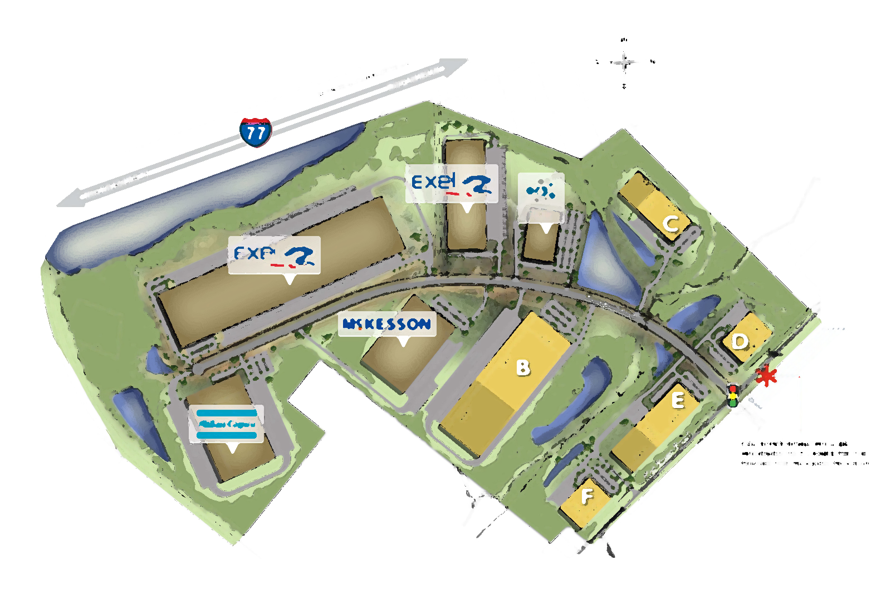
Industrial Development
Rick Norwood

Slide 28
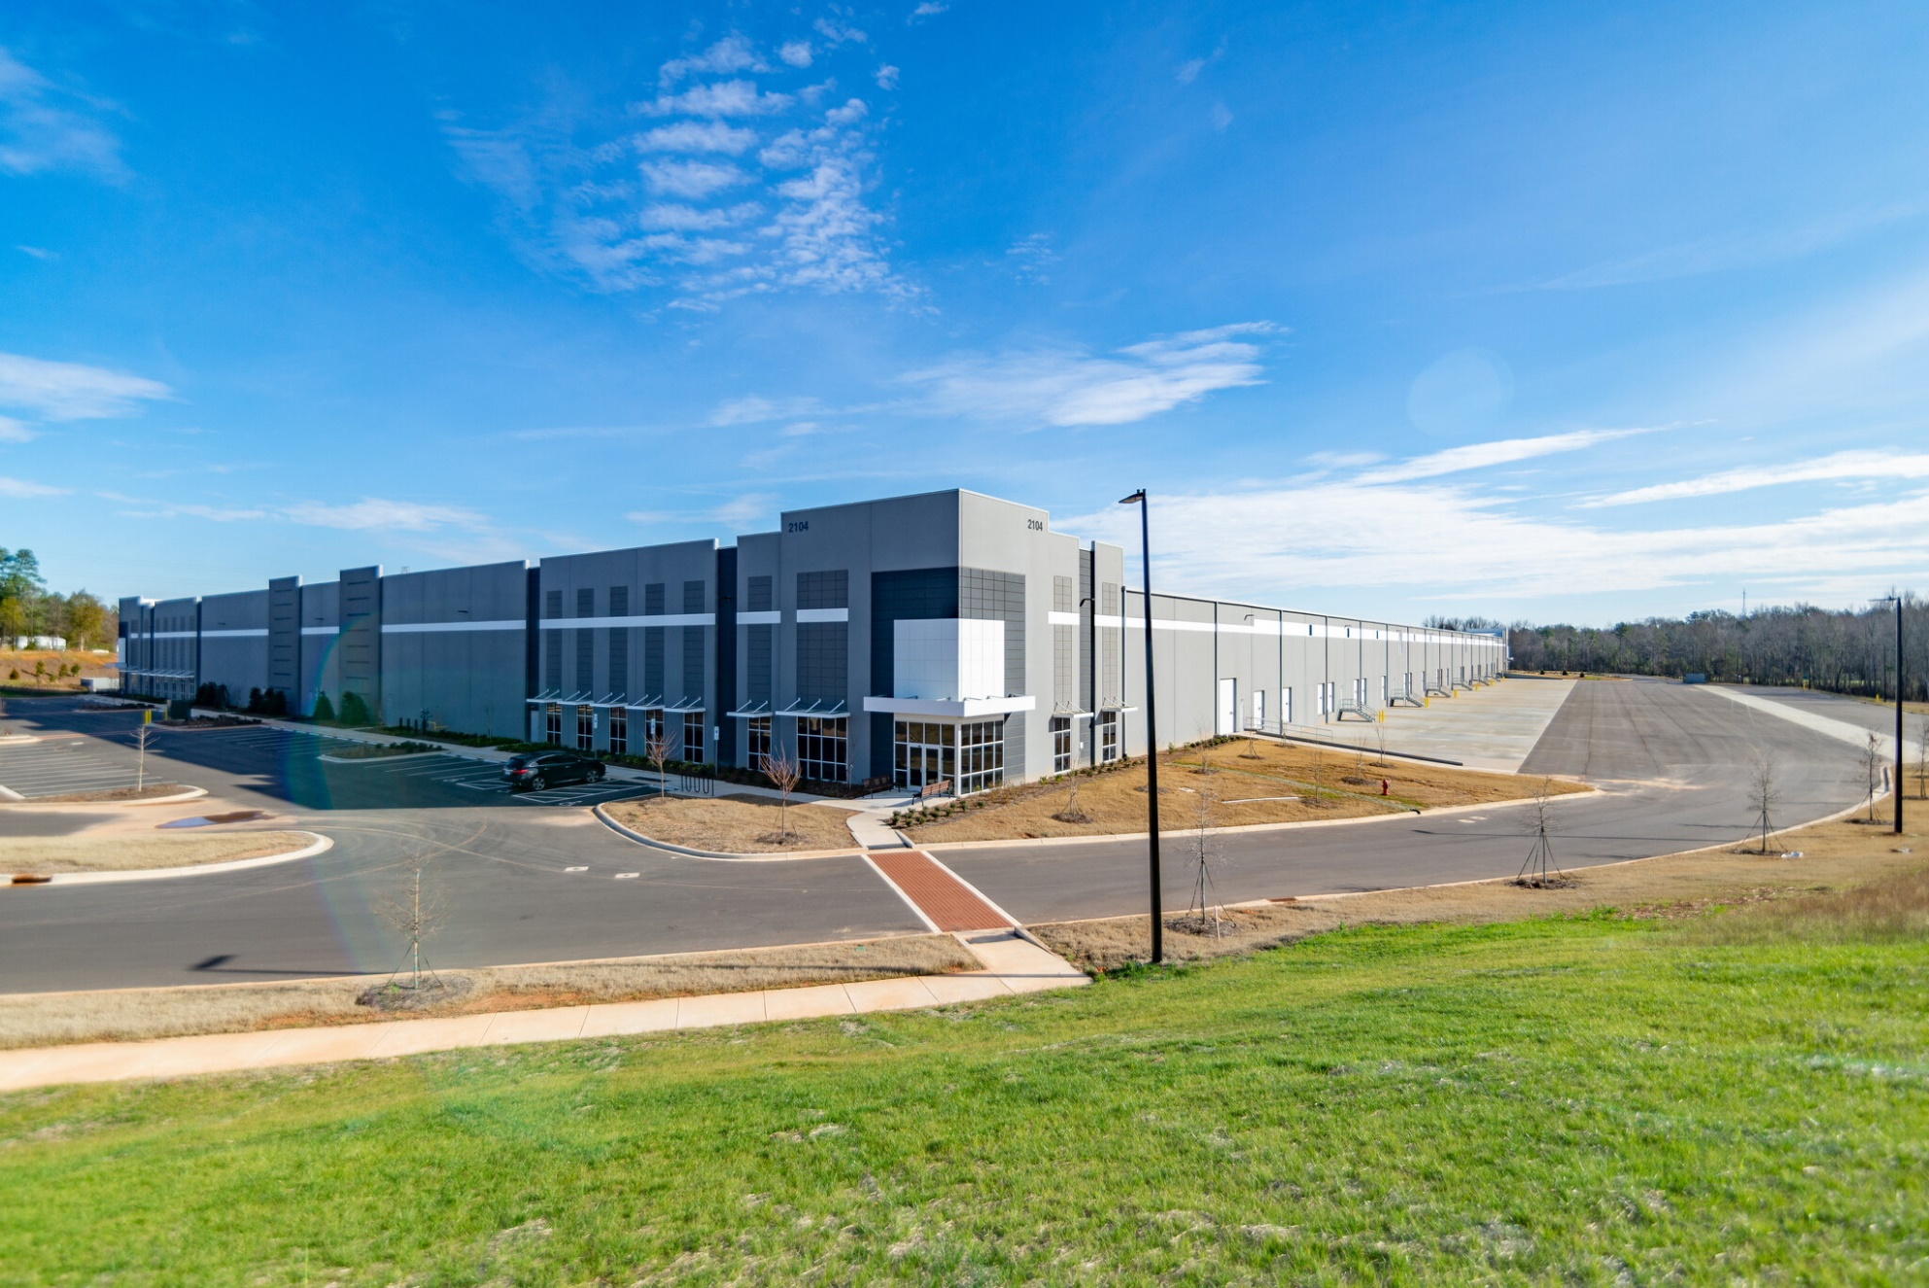
Rock Hill Industrial Parks
Over $900,000,000 in Capital Investment
Over 7,500 New Jobs.

Slide 29
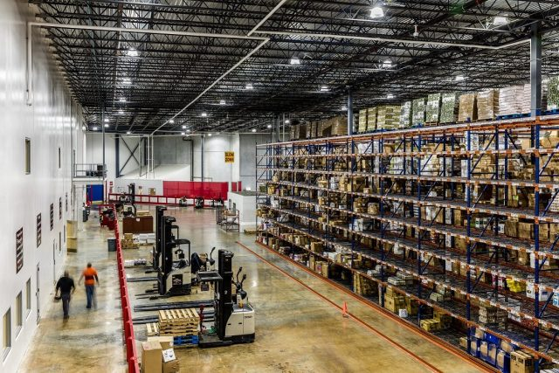
Current Active Projects

Slide 30
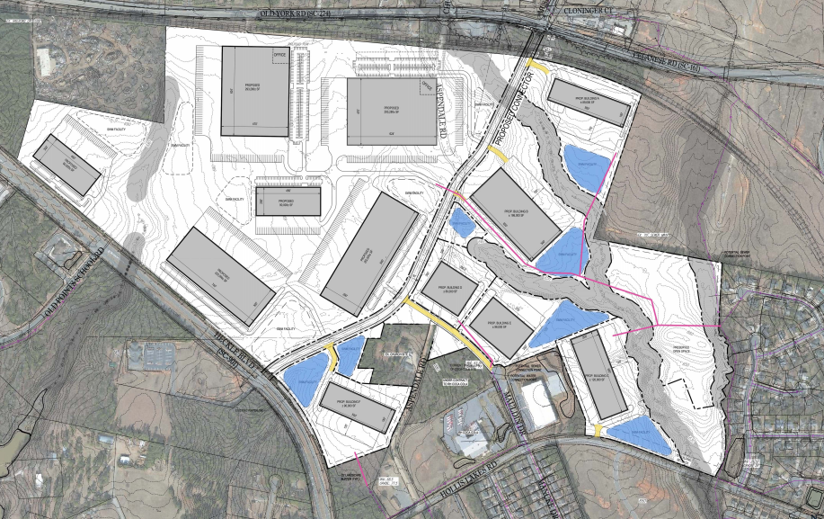
Aspen
Marketing/Signage
Restrictive Covenants
Brokerage Agreement
Virtual Video – In progress

Slide 31

New Aspen Logo

Slide 32


New Aspen Logo & Signage

Slide 33

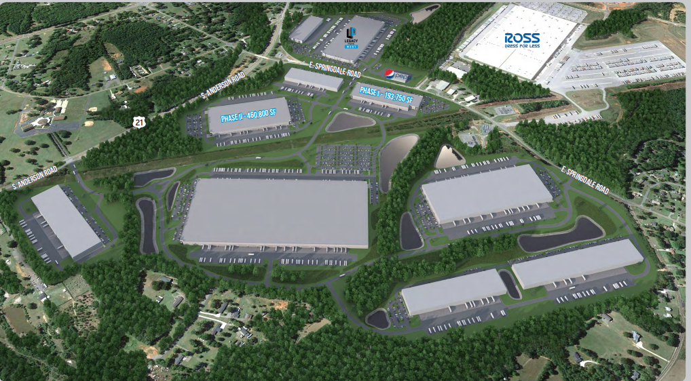

Legacy East
Competed
Prospect Visits
Prospect Activity
Under Construction

Slide 34
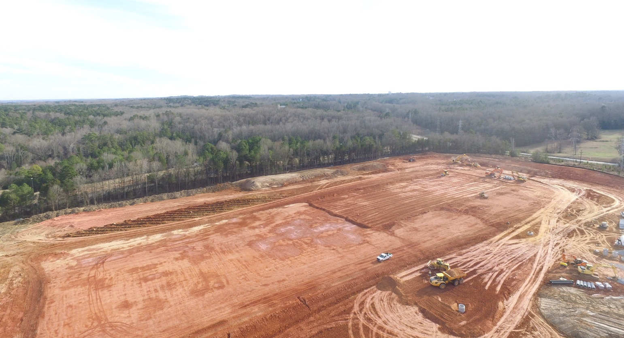

DIRTT Environmental
January 23, 2020

Slide 35
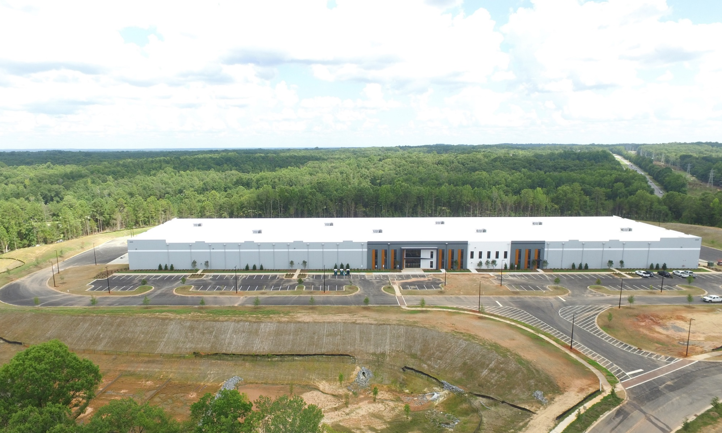
DIRTT Environmental
July 26, 2020

Slide 36
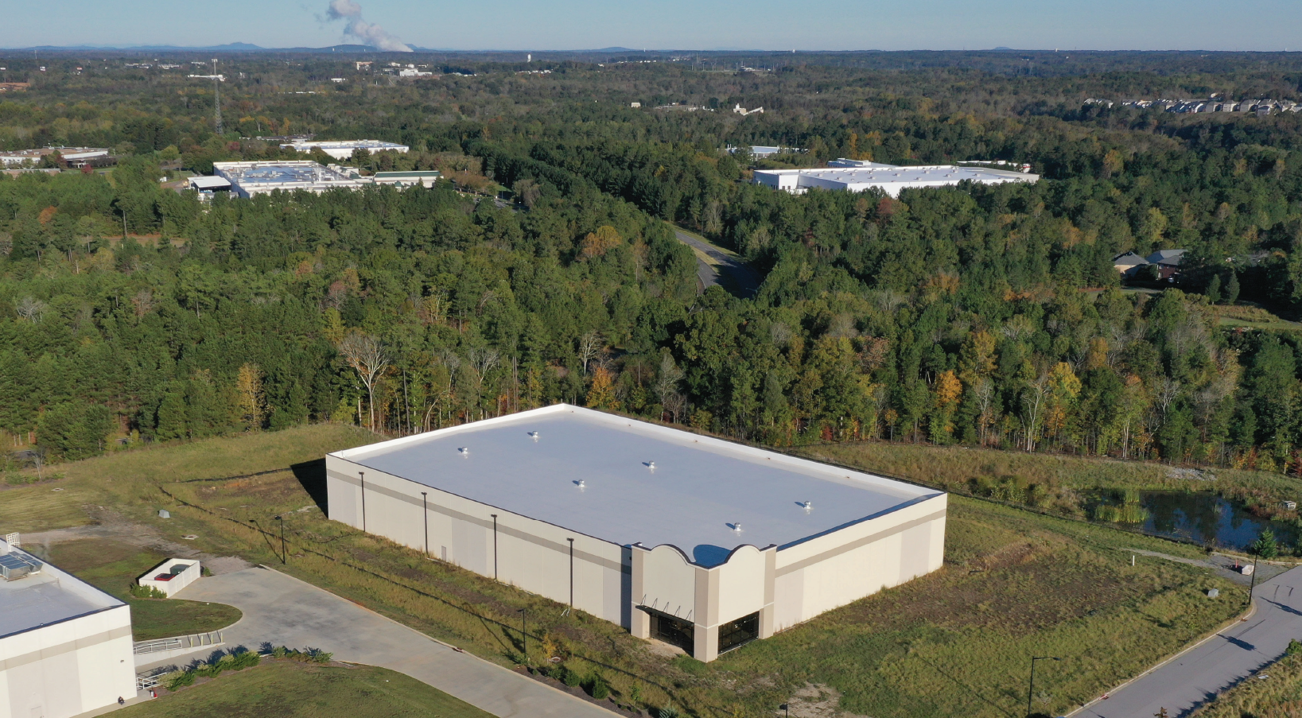
Spec Building
Two New Visits in June-July
LOI received on 7/29/20

Slide 37
SC Commerce Drone
Video Virtual Tour
Rock Hill properties in our first phase of videos
Drone video has been shot:
  Legacy Park
  Aspen
  Knowledge Park
Riverwalk, Riverwalk Business Park, and Firetower Road Business Park (not currently in municipal limits) are on the list for future videos as well as other suggested properties including the RHEDC Waterford shell building (which is currently listed with JLL).

Slide 38
Summary
Ross Stores $31 Million Expansion and 436 New Jobs in Rock Hill
Prospect Activity
  LOI on Waterford Spec Building
  LOI on Site B TechPark (potential $8 Million Investment and 75 New jobs)
  Proposed new facility at TechPark
  BRE Prospect Activity at Southway
  BRE Prospect in Waterford
  New Prospect Activity in Legacy East
  DIRTT Environmental (substantially complete)
  Progress on infrastructure on Randolph Yarns (Rock Hill Commerce Park)

Slide 39
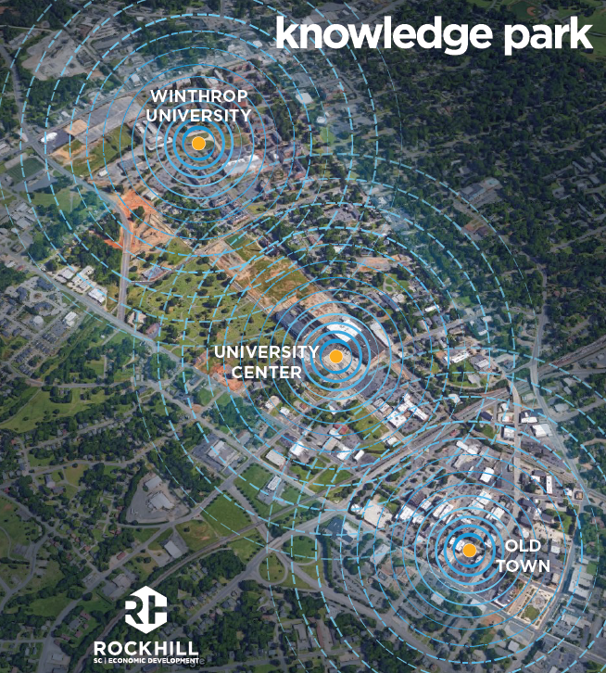

Knowledge Park
David Lawrence

Slide 40
Redevelopment Projects - Updates
Updates:
  The Exchange
  West White Street sites
  Annex Site
  The Link
  Engage at Knowledge Park

Slide 41
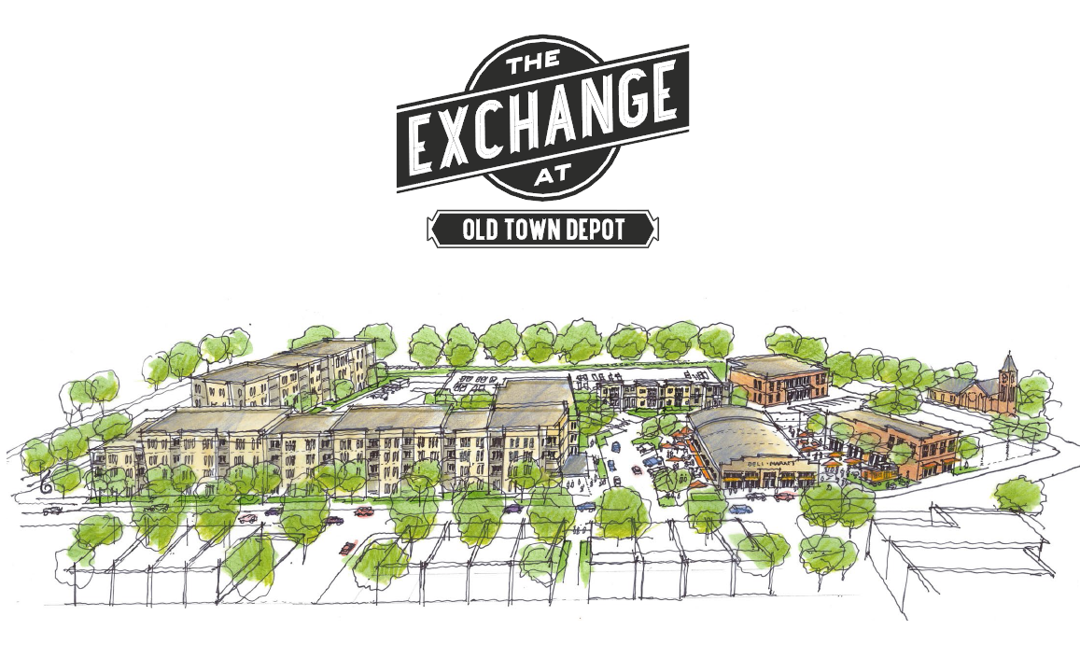
The Exchange
  Development Agreement approved by City Council on June 22nd
  Developer expects to close on the property in mid-September
  Construction should start in October
  Details:
    229 multifamily units, 20,000 square feet of commercial space, 329 parking spaces
    Developer has committed to private investment of at least $40 million
    $600,000 in public improvements
    City reimbursed if the developer
    receives Textile Tax Credits on the site
    City also being asked to fund up to
    $135,000 in Facade Grants and up to
    $500,000 in Growth Management
    Incentives. Both are at the discretion
    of City Council later in the
    development process.

Slide 42
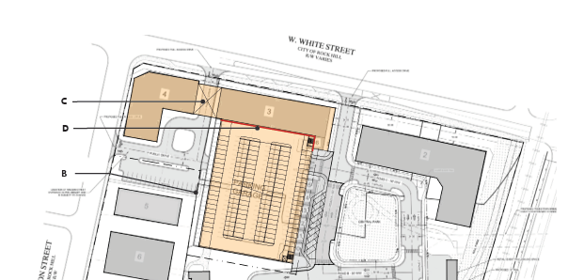
West White Street Sites
  Three parcels are available between Dave Lyle Boulevard and Wilson Street (across from The Cotton Factory):
    Former seafood store site
    Land in front of parking deck to be built
    Used auto sales lot
  Interest in these
  sites for mixed use
  New development
  must integrate with
  pedestrian/cyclist
  bridge

Slide 43
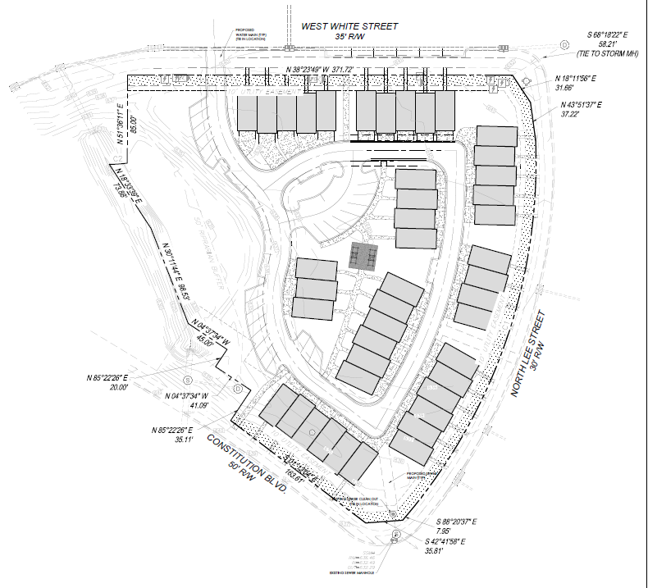
Annex Site
  167 Lee St, LLC executed Purchase-Sale Agreement with RHEDC on July 18th
  167 Lee St, LLC includes
  Justin Smith, Heath Sessions
  and Richard Lane (all local)
  For sale townhomes are
  planned for the site

Slide 44
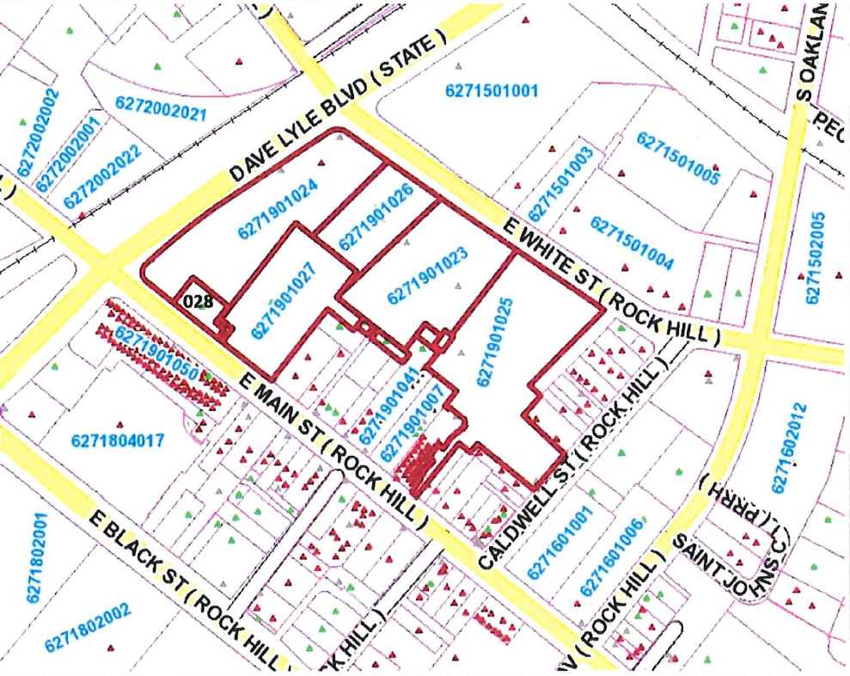
The Link
  RHEDC executed Purchase-Sale Agreement with City of Rock Hill on July 13th
  RHEDC will take the parcels through the Voluntary Clean-up Contract (VCC) process with SC DHEC
  Developer plans 243
  apartment units

Slide 45
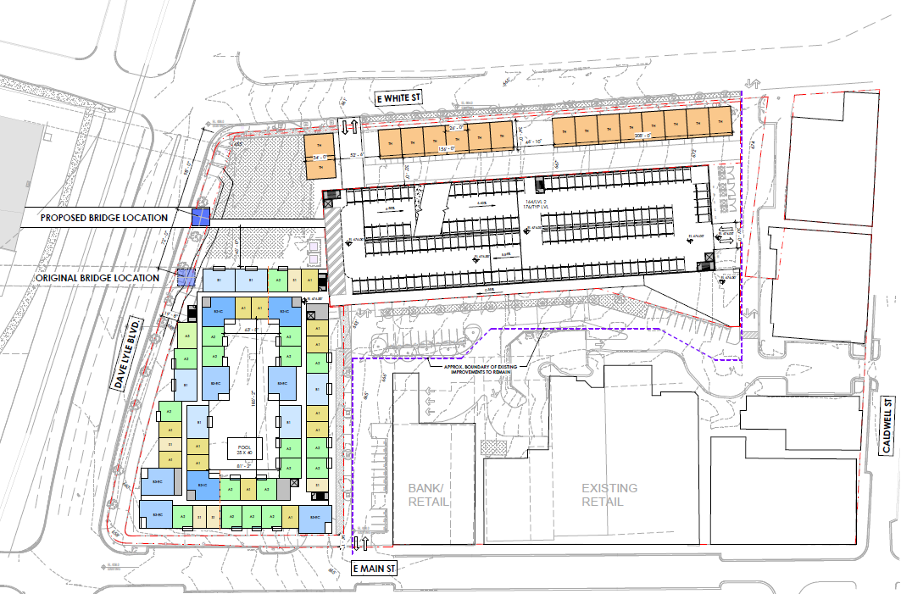
The Link

Slide 46
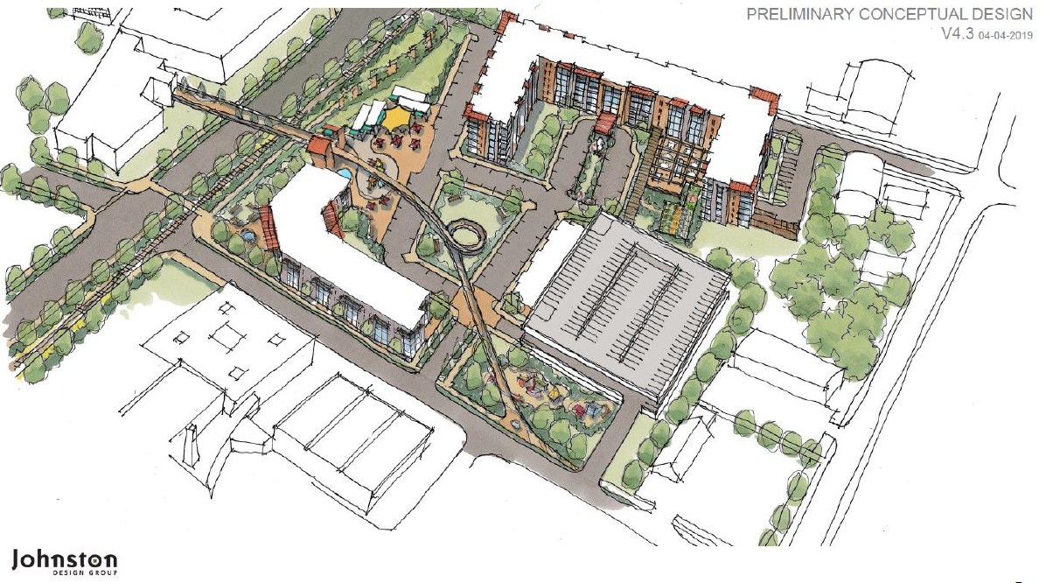
Engage at Knowledge Park
  Work continues on the crafting of a Development Agreement
  Title issue with Norfolk Southern Railway still to be resolved
  Developer plans
  203 senior living
  units (independent
  living, assisted
  living) with a
  $25 million
  minimum
  investment

Slide 47

Technology Incubator
David Warner

Slide 48



Rock Hill VMS Program
Three new VMS Mentees have been evaluated and accepted into the program by the RHVMS Board:

Slide 49

Rock Hill VMS Program
Monthly Volunteer Mentor Meetings Continue
July 22, 2020 regularly scheduled Zoom meeting
Next meeting: August 18, 2020 via Zoom

Slide 50

Knowledge Park e-Network
Informal peer coaching sessions to solve specific business challenges
Next session August 27, 2020
3pm via Zoom

Slide 51




Growth Gazelles
Promising scalable startups receiving one-on-one coaching with the TI Director
MiY Systems, LLC
“Helping you Manage it Yourself”

Slide 52
Relentless Challenge Grant
Inclusive Tech Expo – Planning team consisting of representatives from B.E.L.L., the Technology Incubator, and City Grants staff
This virtual, week-long, event is scheduled from Monday, October 26, 2020 – Friday, October 30, 2020
Each day will have two-hour evening sessions focused on specific topics
Two celebrity guest speakers are now being put under contract
Tickets are $9.99 for the week
Ticket sales will begin in late August

Slide 53




8 a.m.
Wednesday
August 5, 2020

Slide 54
Reminders
Upcoming Events | Date | Time | Place
Monthly Board Meeting | Tuesday, September 1, 2020 | 12 noon | Zoom
Monthly Board Meeting | Tuesday, October 6, 2020 | 12 noon | Zoom

Slide 55
Adjourn
Business Portion of
RHEDC Board Meeting

