Slide 1
Rock Hill Economic
Development Corporation
Board of Directors
Monthly Meeting
Tuesday
June 2, 2020
12 noon

Slide 2
Prior Meeting Minutes
  Consider the minutes from the May 5, 2020
  monthly meeting
  E-mailed to the Board on May 26, 2020
  Request for a motion to approve

Slide 3
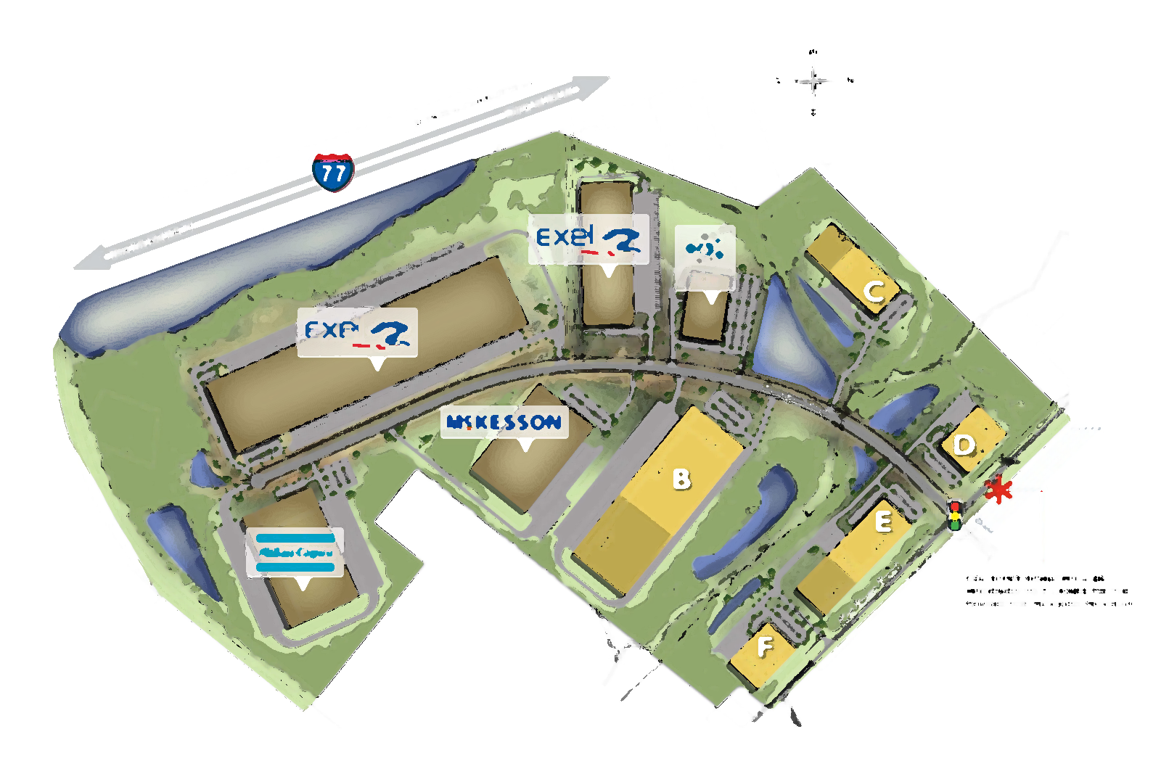
Industrial Development
Rick Norwood

Slide 4
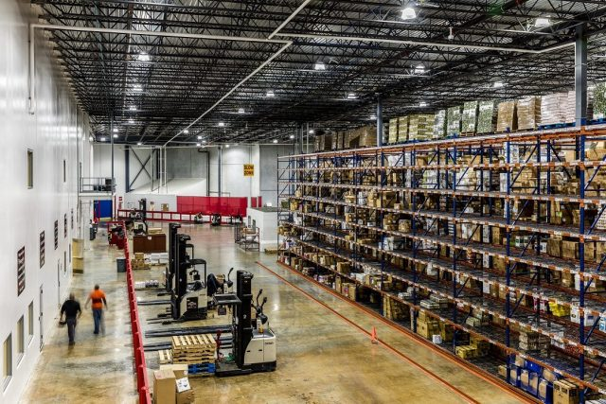
Current Active Projects

Slide 5
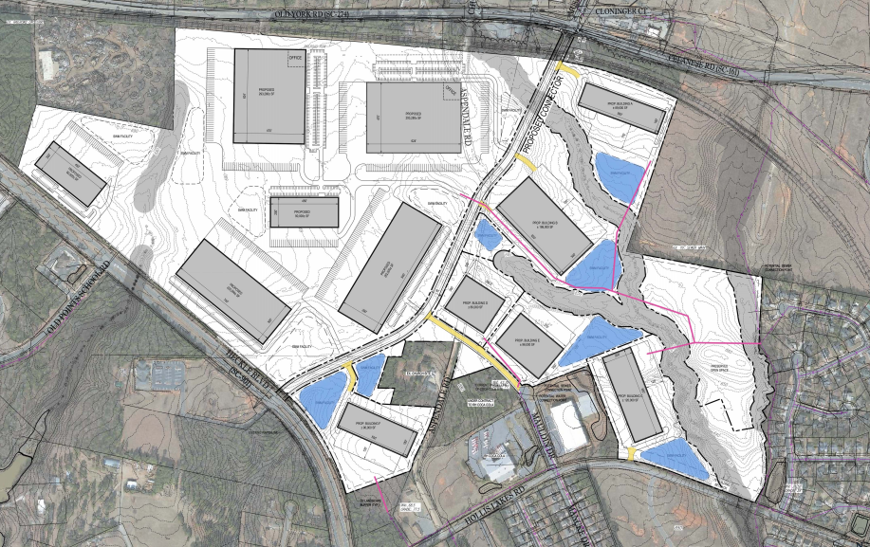
Aspen
Marketing
Signage
Virtual Video

Slide 6



Aspen

Slide 7

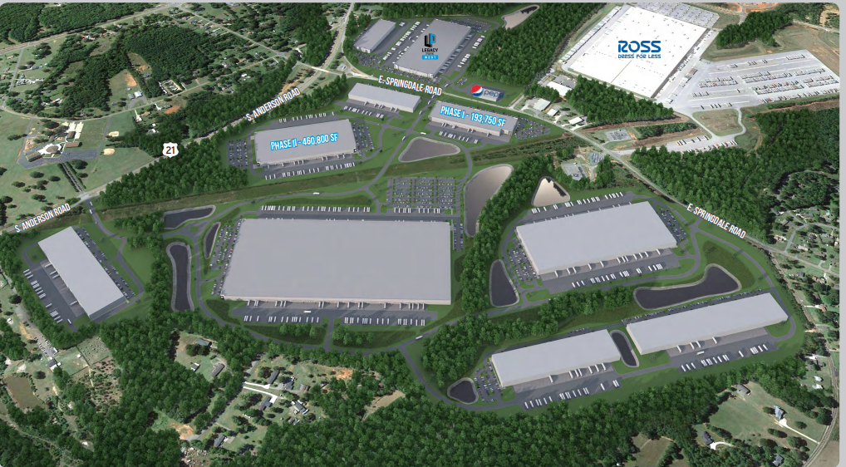

Legacy East
Competed
Prospect Visits
Prospect Activity
Under Construction

Slide 8
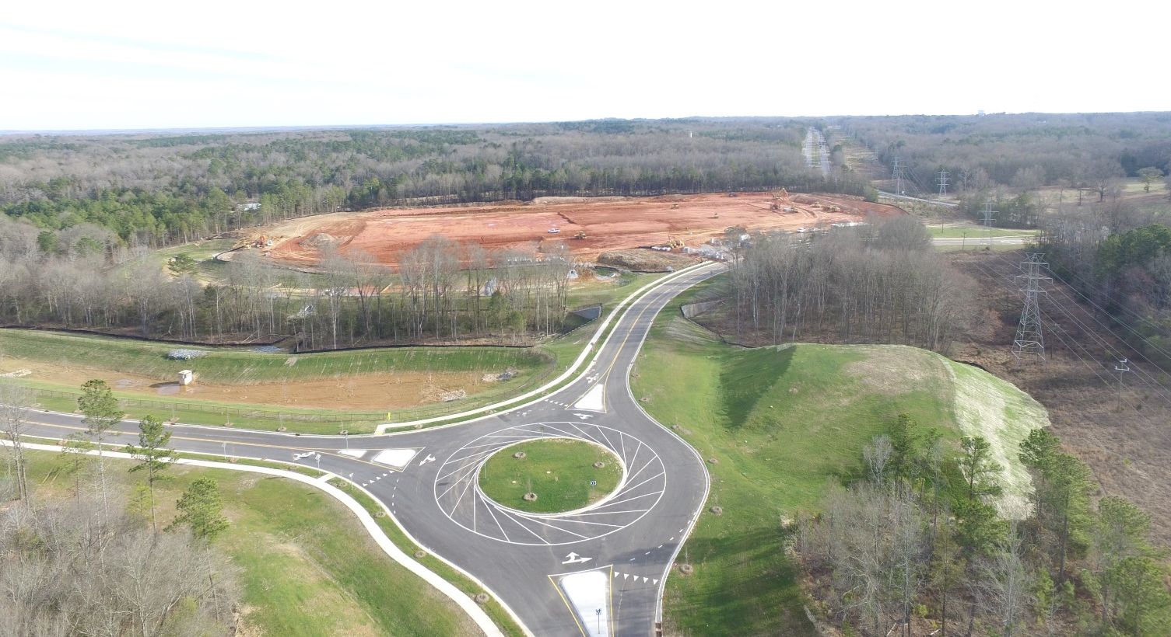

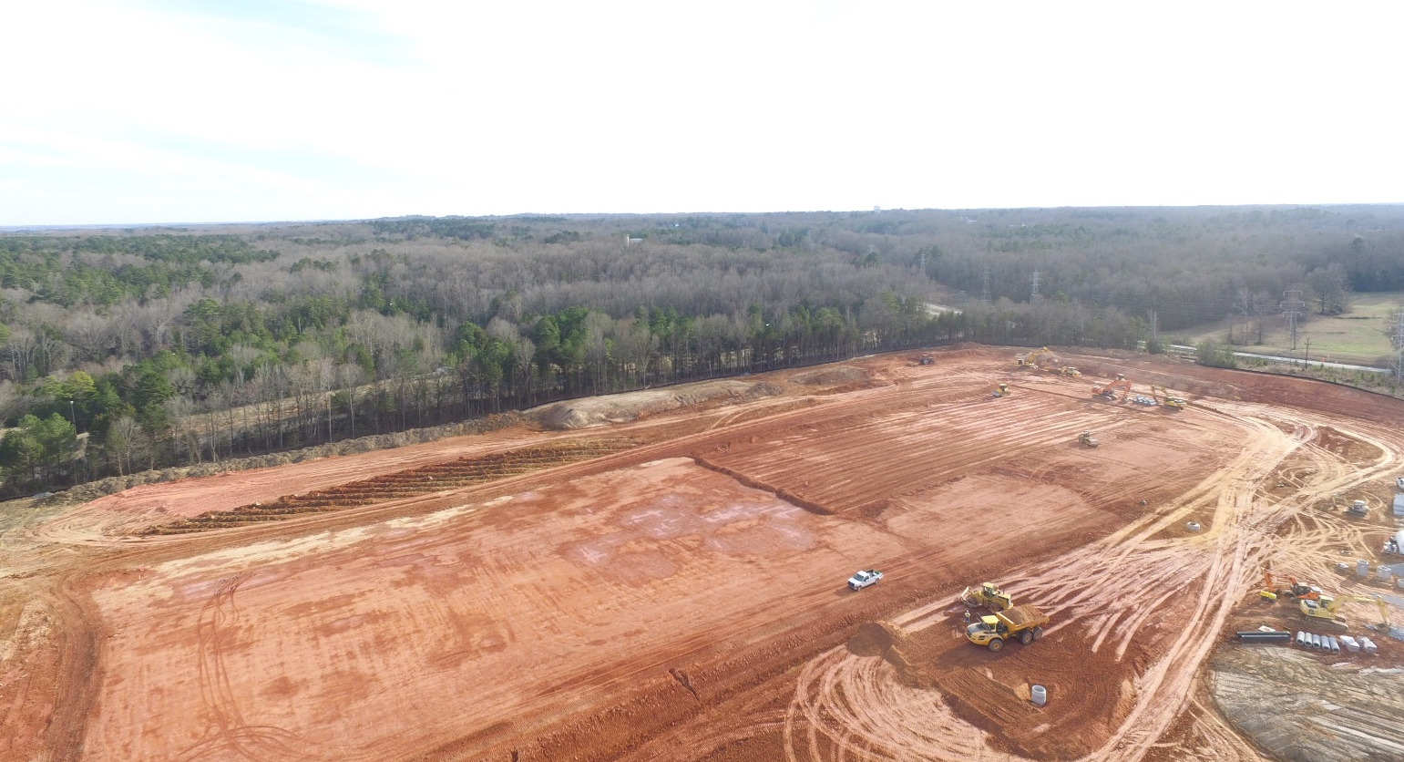
DIRTT Environmental – January 23, 2020

Slide 9
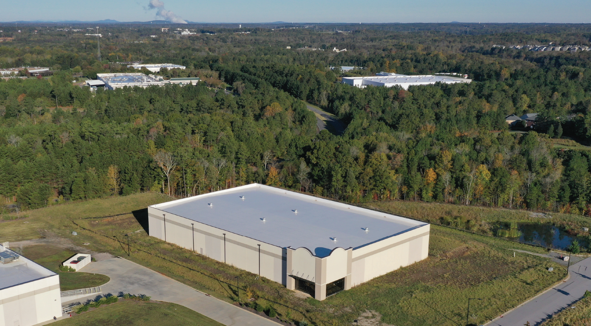
Spec Building
No New Visits in May
One strong lead – call scheduled for next week

Slide 10
Locate SC Site Enhancement Initiative
PROGRAM OVERVIEW
The South Carolina Department of Commerce is continuing the Site Enhancement Initiative for a fifth round of funding to aid in property improvements of available product across the State. This effort is to increase the competitiveness and chances for success of the already quality properties within the State portfolio.
Three million ($3MM) has been set aside for this round of funding. This is a competitive process. Each county may submit one property for consideration and evaluation. The average maximum grant award per property in the past has been approximately $300,000.

Slide 11
SC Commerce Drone Video Virtual Tour
YCED is pursuing a grant opportunity from SC Commerce which is seeking aerial drone videos from county EDOs for industrial (and possibly office) sites.
This is an effort to bolster Commerce’s ability to offer “virtual tour” capabilities to prospects in these uncertain times.
SC Commerce will reimburse county/regional EDOs up to $5,000 per video for up to five sites.
YCED is looking to leverage these funds with local development partners to accomplish a much larger project. They have prepared an RFP which they are looking to send out later this week.

Slide 12
SC Commerce Drone Video Virtual Tour
Rock Hill properties in our first phase of videos
Legacy Park East (existing and future development)
Aspen Business Park – Project Manager to be assigned next week – expect video to be completed in July.
University Center and The Thread (featuring corporate office opportunities) – subject to SC Commerce approval
Riverwalk, Riverwalk Business Park, and Firetower Road Business Park (not currently in municipal limits) are on the list for future videos as well as other suggested properties including the RHEDC Waterford shell building (which is currently listed with JLL).

Slide 13
Video Example (Business Park)
https://vimeo.com/409970023

Slide 14
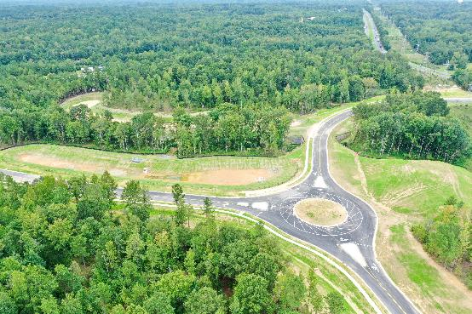
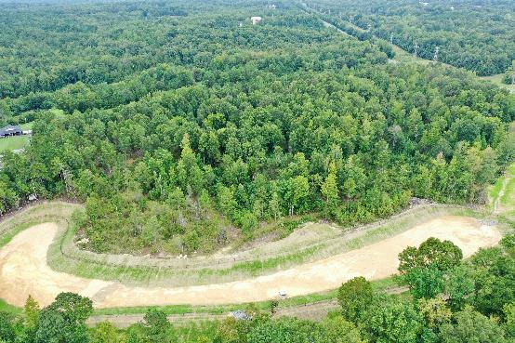
Panther Property – Drone Shot 9/1/19

Slide 15
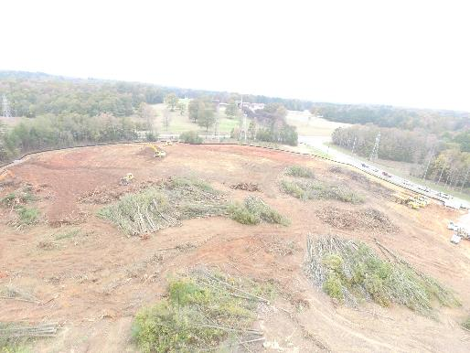
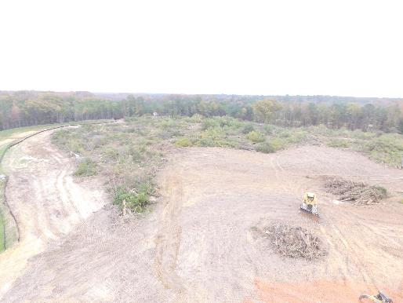
Panther Property – Drone Shot 12/3/19

Slide 16
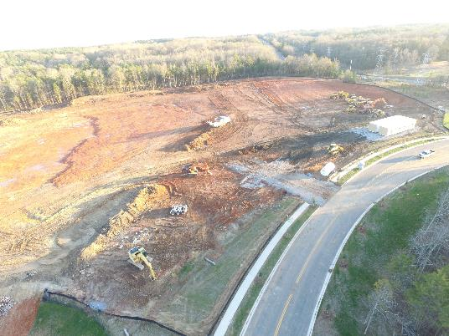
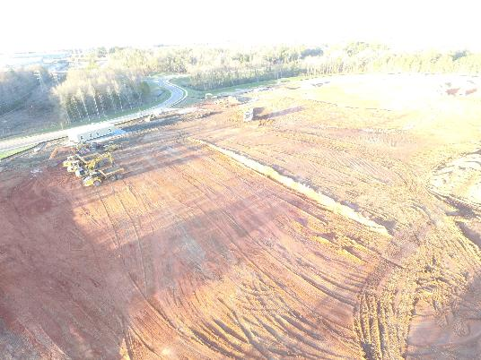
Panther Property – Drone Shot 12/13/19

Slide 17
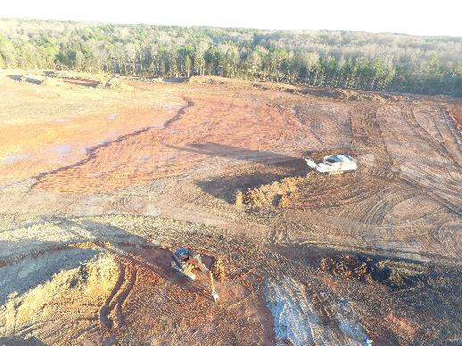
Panther Property – Drone Shot 12/13/19

Slide 18
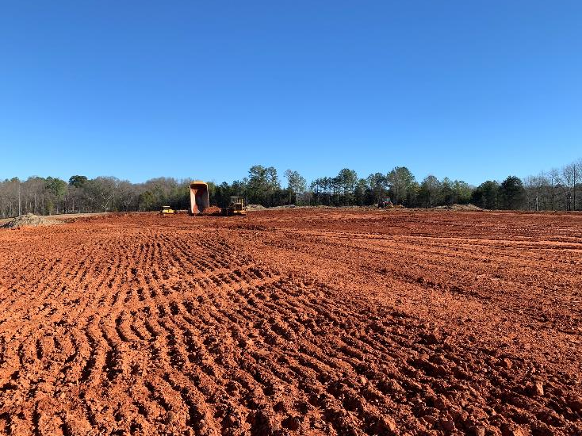
Panther Property – December 31, 2019
Standing in a spot that would be in the middle of the building looking down towards the receiving docks.

Slide 19
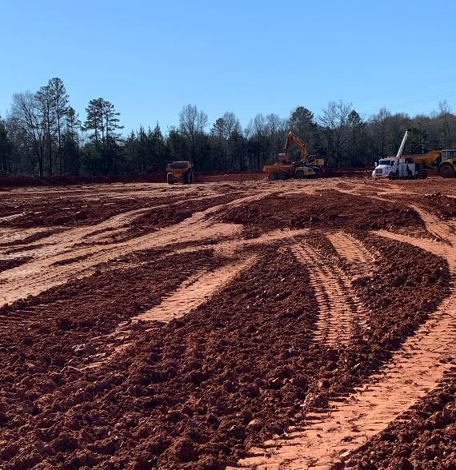
Panther Property – December 31, 2019
Standing in a spot that would be in the middle of the building rotated looking down towards the shipping docks

Slide 20
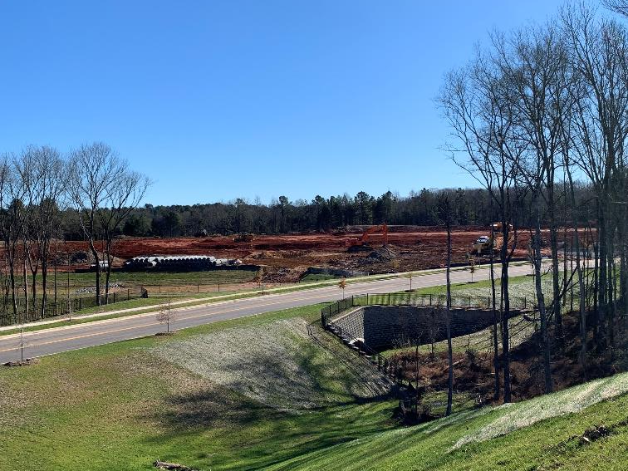
Panther Property – December 31, 2019
Standing on hill in the distance looking at what will be the front of the building.

Slide 21
Panther Property – December 31, 2019
Links to two different video shots of the property on 12/31/19. Enjoy!
https://share.icloud.com/photos/04exQWbUn6w73QjVHYYEZPi_w
https://share.icloud.com/photos/01B72nSnAlijlJFpz6uxerNPA

Slide 22
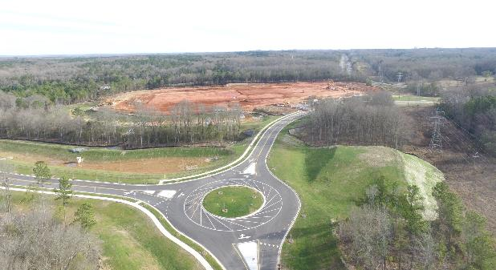
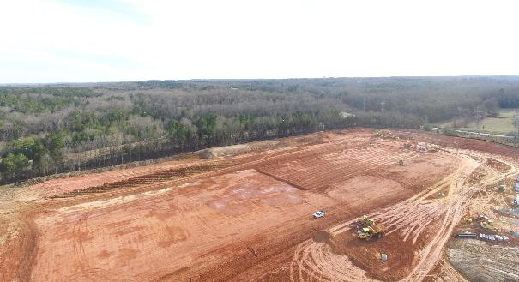
Panther Property – January 23, 2020

Slide 23
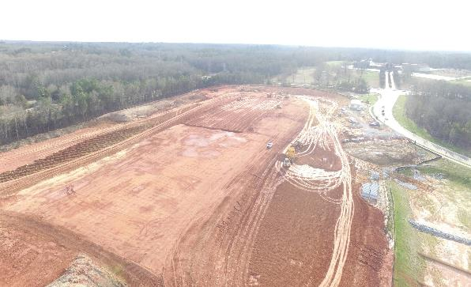
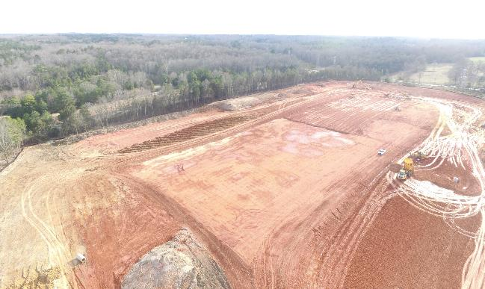
Panther Property – January 23, 2020

Slide 24
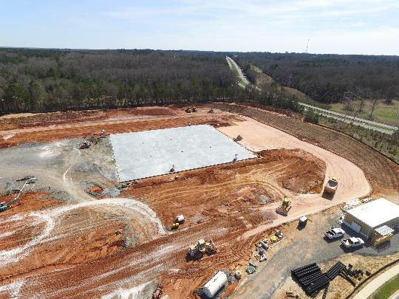
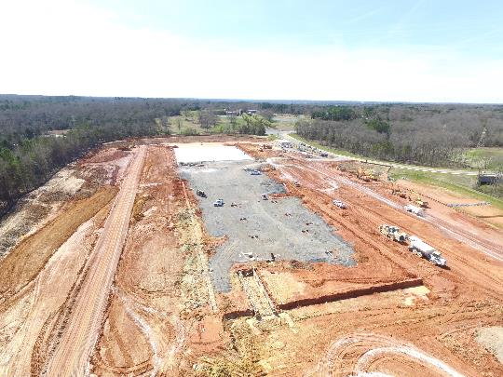
Panther Property – March 6, 2020
First Concrete Slab Pour Complete – 40,000 sq/ft

Slide 25
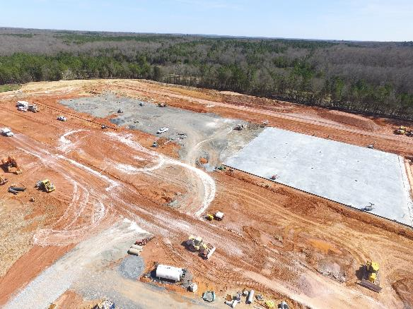
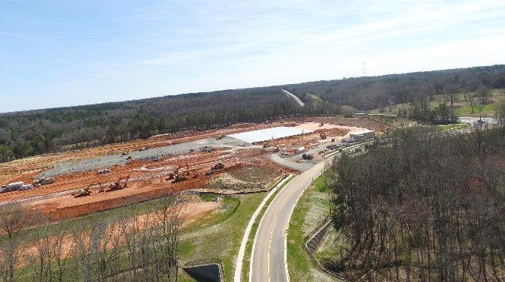
Panther Property – March 6, 2020
Stone added for Phase 2 and 3 Concrete Pours

Slide 26
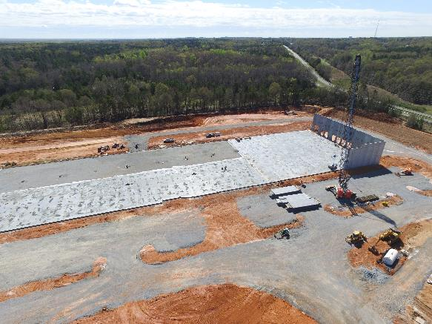
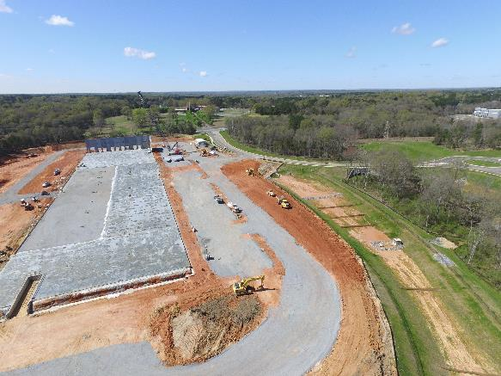
Panther Property – March 21, 2020
Second Concrete Slab Pour (Phase 2) Complete – estimate 55,000 sq/ft
Concrete Wall Install Started on Shipping Side of Building

Slide 27
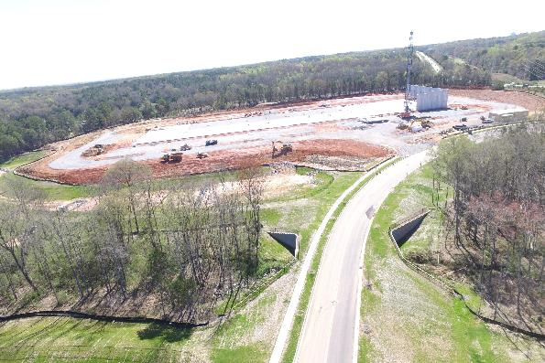
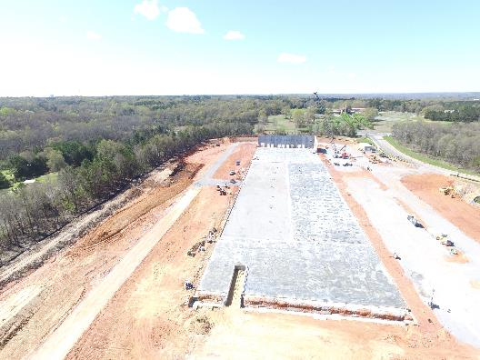
Panther Property – March 21, 2020
Gravel/Stone in place for Parking Lot Areas

Slide 28
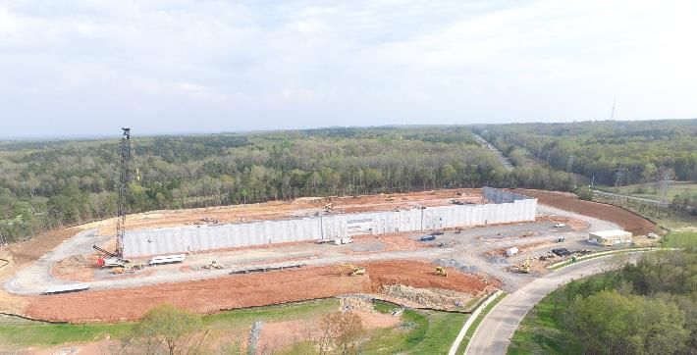
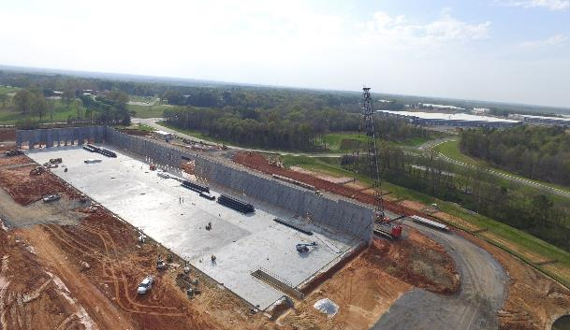
Panther Property – March 27, 2020

Slide 29
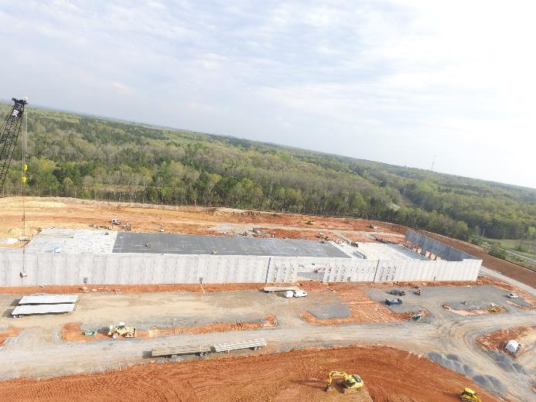
Panther Property – March 27, 2020

Slide 30
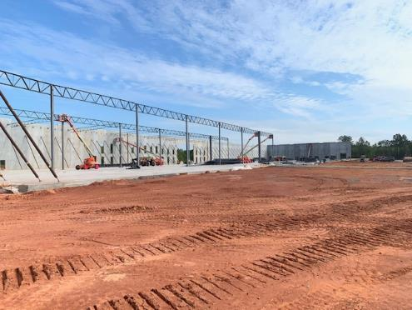
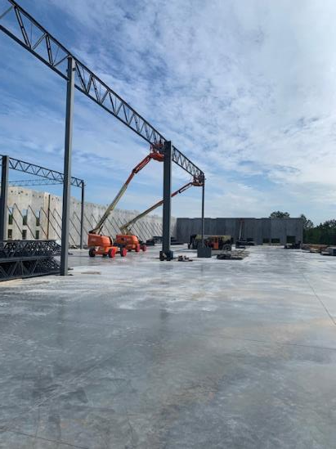
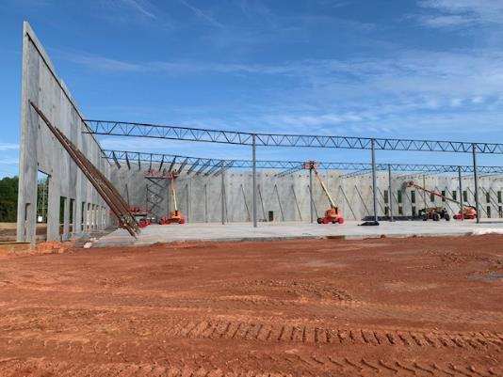
Panther Property – April 18, 2020

Slide 31
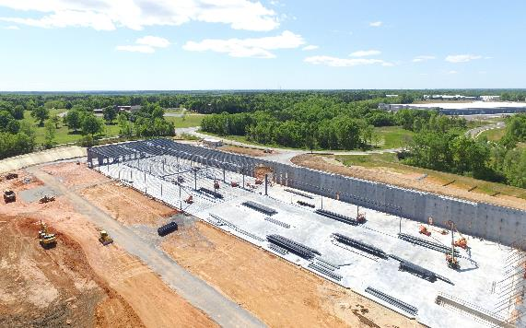
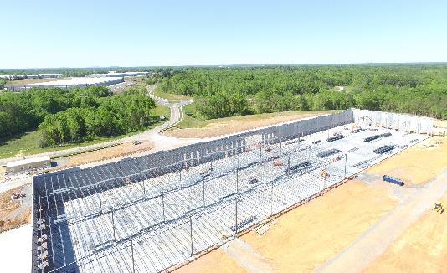
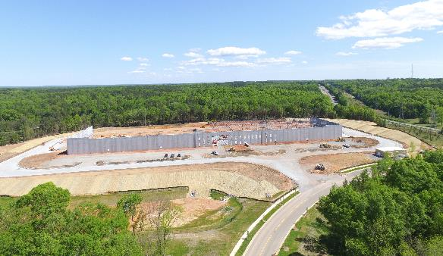
Panther Property – April 18, 2020

Slide 32
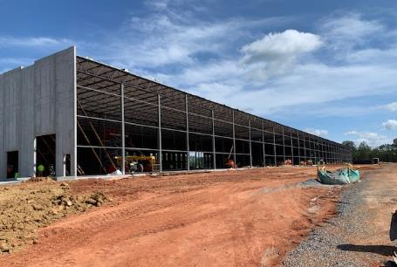
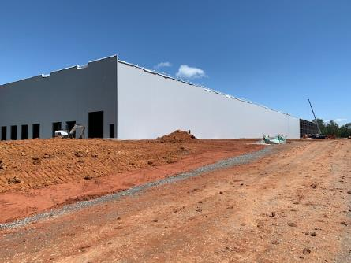
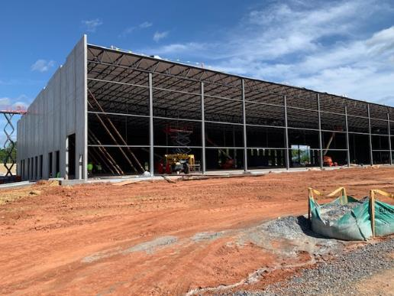
Panther Property – May 2-5, 2020

Slide 33
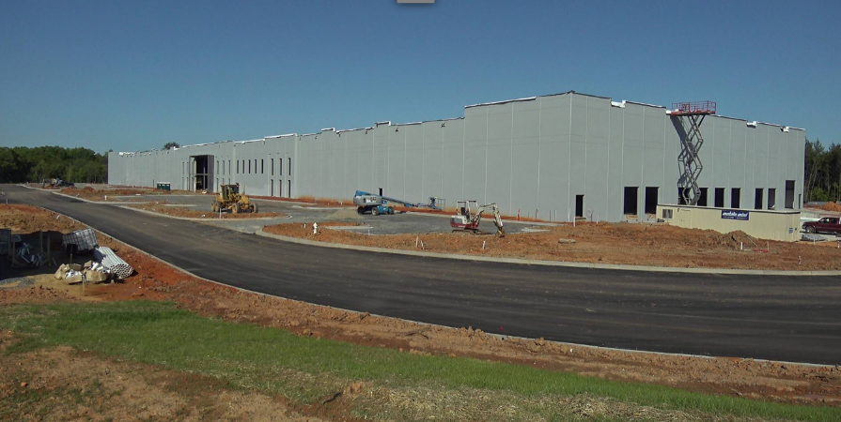
Panther Property – May 6, 2020

Slide 34
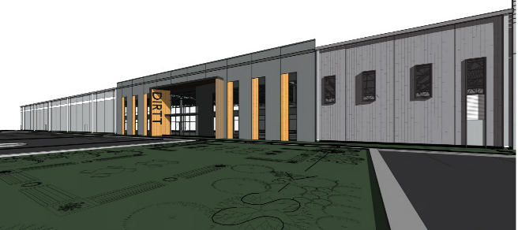
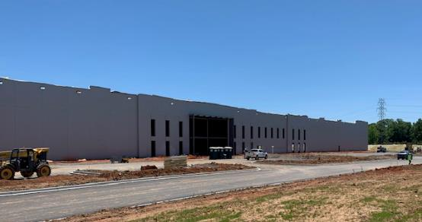
Panther Property – May 11, 2020

Slide 35
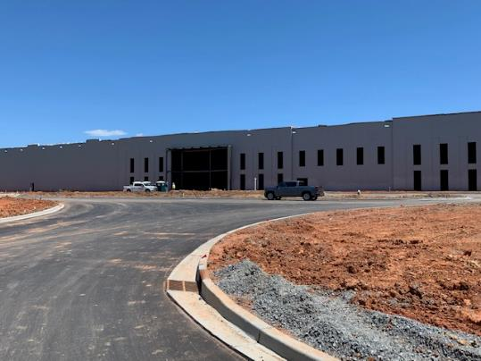
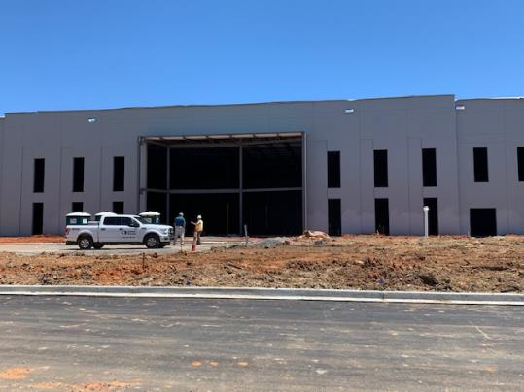
Panther Property – May 11, 2020

Slide 36
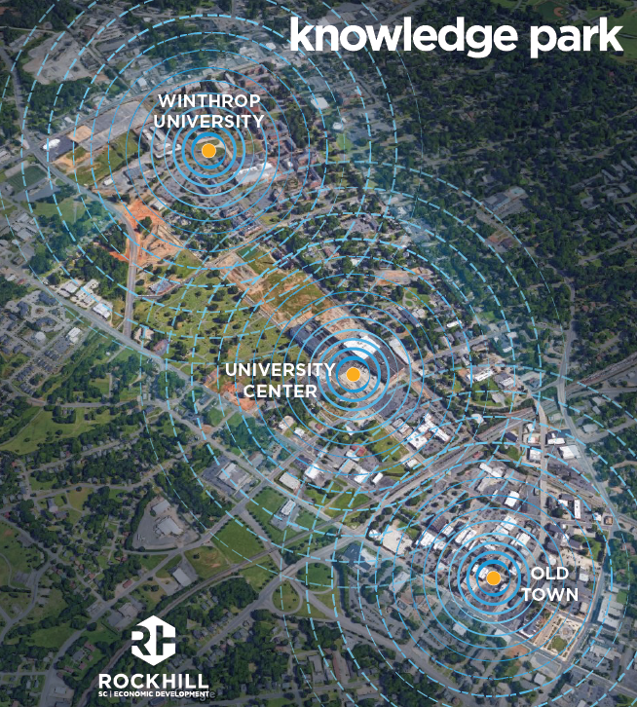

Knowledge Park
Stephen Turner

Slide 37
Redevelopment Projects - Updates
Updates:
  4 Growth Management Incentive applications; Brad Hastings
  Oakland Auto development agreement
  The Exchange parking
  West White Street sites
  South Wilson Street site

Slide 38
Growth Management Incentives
  Approved - Habitat for Humanity building an affordable home on Hagins Street
  Housing Development Corporation of Rock Hill seeking water meter set fees reimbursed for 6 affordable rental homes on 5 different streets
  Walk2Campus will revitalize 113 Hampton Street, including adding a second floor; assistance sought
  An application to assist with eligible expenses at the retail buildings to be redeveloped as part of The Exchange project will be submitted shortly.
  Brad Hastings has joined the Growth Management Incentive Review Committee representing RHEDC (recused from consideration of the Walk2Campus application)

Slide 39
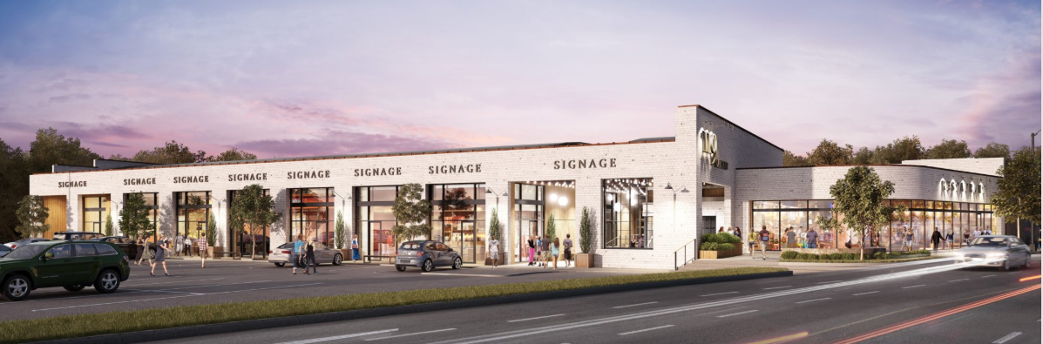
Oakland Auto – development agreement
  119 South Oakland Avenue
  Lat Purser and Associates purchased the property in February 2019
  Office, retail, and restaurant uses are contemplated
  Development agreement requires a construction start date by 12/31/2020
  Leasing activity had been slow and COVID-19 has made matters worse
  City Council will be asked to consider a 6 month extension of the start date
  Another 6 month extension may be sought (approval at the City Manager’s discretion)

Slide 40
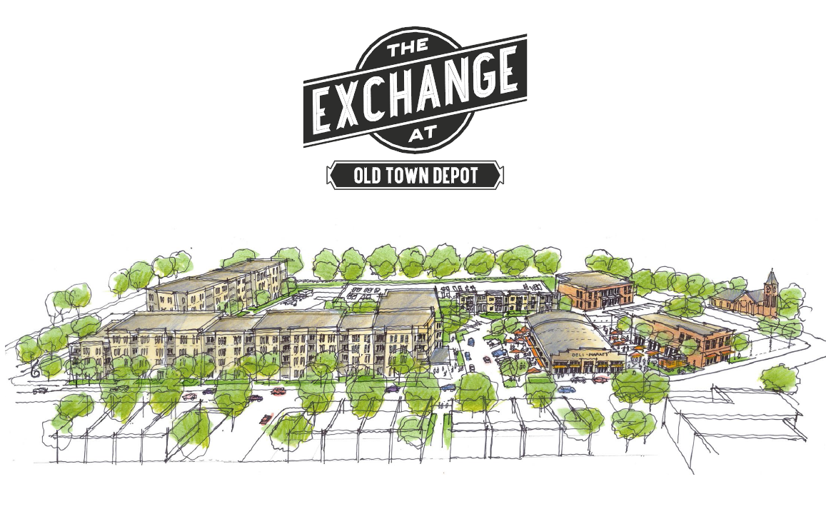
The Exchange - Parking
  Parking has been one of the last issues to be resolved
  Parking deck first proposed but later removed from the planning
  Residential uses can be parked on the parcel
  Commercial uses are short on the parking needed
  Commercial buildings will be included in the Downtown Parking Management Plan and pay into the system
  With the parking issue resolved and
  York County having signed the
  Purchase-Sale Agreement,
  City Council will consider a
  development agreement soon

Slide 41
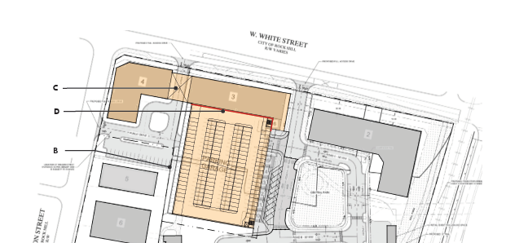
West White Street Sites
  Three parcels are available between Dave Lyle Boulevard and Wilson Street (across from The Cotton Factory):
    Former seafood store site
    Land in front of parking deck to be built
    Used auto sales lot
  Interest in these
  sites for mixed use
  New development
  must integrate with
  pedestrian/cyclist
  bridge

Slide 42

South Wilson Street Site
  Developer proposes the development of multi-family residential across from the U.S. Post Office
  Letter of Intent in place
  Soil gas found on the property;
  a vapor barrier and venting
  will likely be pursued

Slide 43

Technology Incubator
Robert Alexander

Slide 44
Rock Hill VMS Program
New RHVMS Mentee Applications being processed
by the RHVMS Board and staff
***
Over 20 new applications have been received already and more are coming in

Slide 45

Rock Hill VMS Program
Monthly Volunteer Mentor Meetings
May 19, 2020 regularly scheduled meeting
Next meeting, June 24, 2020 via Zoom

Slide 46

Knowledge Park e-Network
Informal peer coaching sessions to solve specific business challenges
May 21, 2020 session via Zoom
Next session June 25, 2020 at 3pm via Zoom
Several Entrepreneurship Committee members and VMS Mentors are now participating in these discussions along with the entrepreneurs

Slide 47

Relentless Challenge Grant
Inclusive Tech Expo – Largest element of the grant, originally part of the Knowledge Park Master Plan
Planning team consisting of representatives from B.E.L.L., the Technology Incubator, and City Grants staff
Moving to be virtual format, exploring use of “Hop-In” conference software
Event will now be week-long, from Monday, October 26, 2020 – Friday, October 30, 2020
Each day will have two-hour evening sessions focused on specific topics

Slide 48




8 a.m.
Wednesday
June 3, 2020

Slide 49
Finance
Committee
Dawn Johnson
Committee Chair

Slide 50


  E-mailed to the Board
  Finance Committee reviewed at May 28th meeting

Slide 51
  Primary income included:
  accrued operating reimbursements; rental and interest income
  Primary expenses included:
  activities for Aspen; legal fees; the Talent Pipeline program; and interest expense
  Motion from the Finance Committee to approve Financial Reports from April 2020

Slide 52
Aspen Business Park
  Property Tax
  SC DOR has approved the application for tax exemption on RHEDC’s property.
  Aspendale Road and Railroad Crossing
  The agreement with Norfolk Southern for a new crossing has been executed.
  RHEDC’s attorney is beginning the process for a judicial closing of the portion of Aspendale Road from Celanese Road to where Aspendale intersects with the future Museum Road extension.
  Development Agreement
  The development agreement between RHEDC, Childress Klein and the City of Rock Hill is in early draft form. We hope to bring that agreement to the RHEDC Board for consideration by August.

Slide 53
Aspen Business Park
Transportation Impact Analysis
SC DOT intends to make Aspen Business Park responsible for off-site road and intersection improvements that are unrelated to Aspen.
Estimating $700,000-$800,000 of new costs to be added to the original $2.7 million phase one project.
Staff is working with the project engineers and SCDOT to limit the scope and costs of these new elements.
Staff is also working to identify and secure additional funding for these unexpected costs.

Slide 54
Waterford Spec Building
LocateSC Site Enhancement Initiative
RHEDC will be submitting a grant application to SC Commerce for $300,000 under the LocateSC Site Enhancement Initiative.
Funds would be used to make site improvements including driveways, parking, landscaping and storm drainage.
If the application is approved, a grant agreement will be presented to the RHEDC Board for approval at a future meeting.

Slide 55
Good Motors / The Exchange
  The contract amendment between RHEDC and York County has been executed. This amendment set the purchase price for the property at $2 million.
  RHEDC has received full reimbursement from York County for environmental expenses as called for in the contract.
  The Purchase and Sale Agreement between RHEDC and Catalyst will be executed very soon.
  The Development Agreement between Catalyst and the City of Rock Hill will be presented to the City Council for first reading on June 8th.

Slide 56
Good Motors / The Exchange
  Consider Development Fee and Art and Amenities Fund Agreement
  Proposed agreement between RHEDC and Catalyst, contingent on Catalyst purchasing the property from RHEDC
  RHEDC to receive $250,000 to be used for mutually agreed upon art installations at The Exchange
  RHEDC to receive $65,000 for its efforts in the redevelopment of the site
Request a motion to approve the proposed Development Fee and Art and Amenities Fund Agreement between RHEDC and RH APARTMENTS QOZB, LLC (Catalyst Capital Partners), subject to any changes recommended by RHEDC’s legal counsel.

Slide 57
Quality of Life
Committee
Melanie Jones
Committee Chair

Slide 58

Funds Raised to Date
 | 2015 | 2016 | 2017 | 2018 | 2019
Goal | $7,500 | $7,500 | $7,500 | $7,500 | $7,500
Total Raised | $7,500 | $7,500 | $6,055 | $6,650 | $300
Projects RHEDC has supported to date:
  Freedom Walkway
  Knowledge Park Roundabout
  Bleachery Heritage Project

Slide 59
Marketing
Committee
Bud Dark
Committee Chair

Slide 60
Talent Development Committee
Matt Dosch
Committee Chair

Slide 61
Entrepreneurship
Committee
Robert Alexander
Committee Chair

Slide 62
Reminders
Upcoming Events | Date | Time | Place
Annual Meeting | Thursday, June 18, 2020 | 5 pm | Zoom
Monthly Board Meeting | Tuesday, August 4, 2020 | 12 noon | Zoom

Slide 63
Adjourn

