Slide 1
Rock Hill Economic
Development Corporation
Board of Directors
Monthly Meeting
Tuesday
May 4, 2021
12 noon via Zoom
&
Rock Hill Sports & Events Center

Slide 2
AGENDA
Mission: To benefit Rock Hill economically by fostering increased employment opportunities and by expansion of business and industry; thereby, lessening the burdens of government and combatting community deterioration.
Call to Order and Welcome
Approve Minutes of the April 13, 2021 Monthly Meeting
Reports/Project Updates

Slide 3
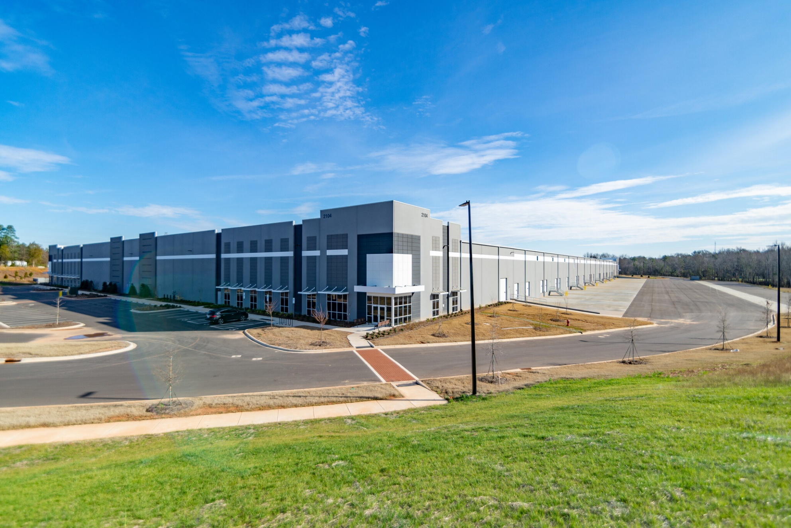
Prospect Report
Rick Norwood

Slide 4
Aspen Infrastructure Update
Sewer Line is Compete
SC DOT; Army Corp; N/S permits are progressing quickly
Bids will be let in late spring and construction should start in late summer.

Slide 5
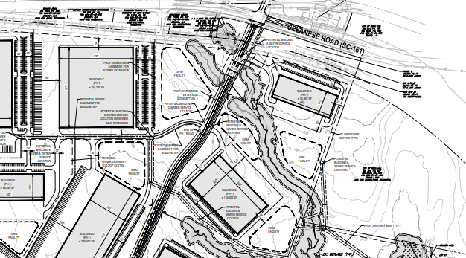
LOI Aspen Building B
DELAYED
Buyer: Approximately 18.5 Acres
Price: $65,000 per acre for developable and $5,000 for undevelopable
Plans to build 150,000 SF Class A building
End user is a manufacturing company currently located in Charlotte
Investment and Job numbers are TBD.
RECON
SITE B

Slide 6
Summary
NEW & On-Going Projects
  Project Recon – PSA nearly competed - Aspen ($6.5MM investment, 74 New Jobs)
  Scentsy Upfit nearly complete ($6MM investment, 200+ New Jobs) – Legacy East
  3D Systems – in plan review($13MM investment, 50 New Jobs) - Waterford
  Spec Building Interior Up Fit – in plan review – TAG.AERO – Waterford
  Proposed new medical facility at TechPark in plan review
  Construction nearly complete: Overview Drive - Waterford
  New Southway Project in plan review
  DIRTT Environmental – opening in June - Legacy East
  Arrival interior up fit under way – Legacy East
  New LOI – Aspen Building B Delayed
  Milly Mattress announced - Riverwalk
Prospect Activity
  Site I TechPark Under Contract
  Site A&B TechPark Under Contract
  Legacy East – Large Prospect ($300M Investment, 625 Jobs)
  Rock Hill Commerce Center Prospect ($45MM investment 160 jobs)

Slide 7
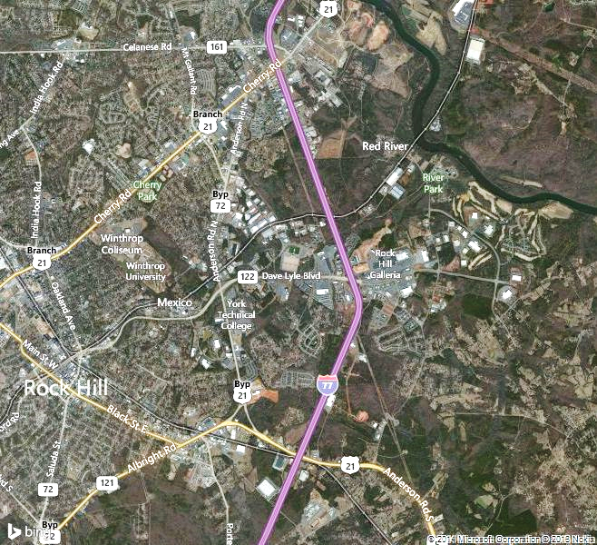
Aspen
River-walk
RHCC
Water-ford
Tech-Park
Legacy

Slide 8

Technology Incubator
David Warner

Slide 9


Knowledge Park e-Network
Informal peer coaching sessions to solve specific business challenges
Meets the 4th Thursday of every month from
3:00-4:30pm via Zoom (May 27, 2021)

Slide 10




Growth Gazelles
Promising scalable startups receiving one-on-one coaching with the TI Director

Slide 11

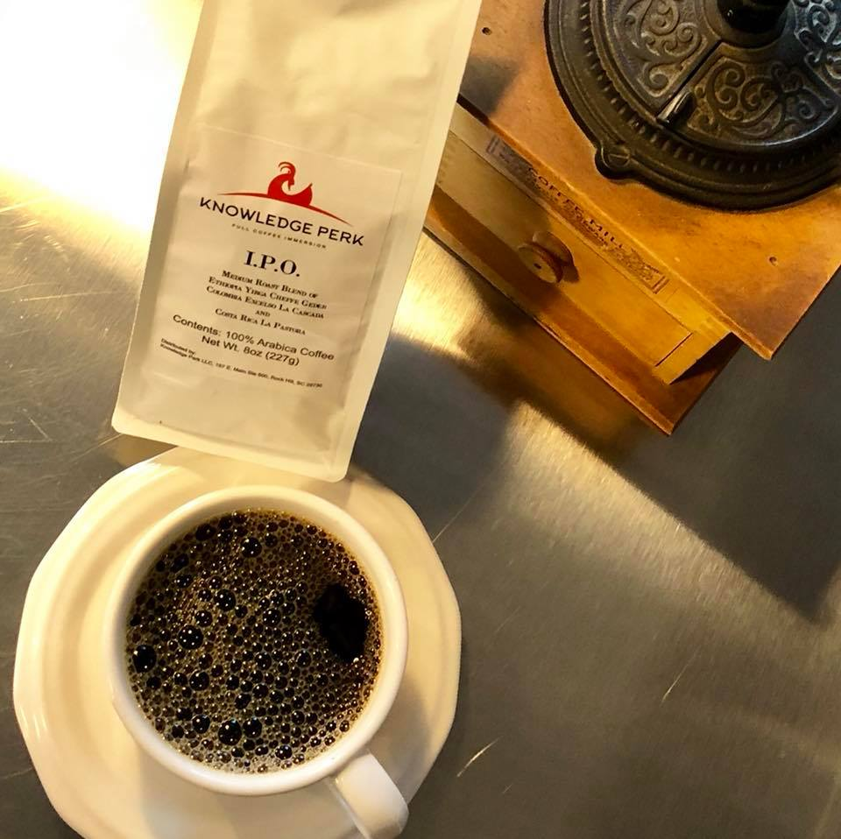
BREAKING NEWS !!!
The highly successful local 1 Million Cups program sponsored by the Kauffman Foundation is now the …
8 a.m.
Wednesday
May 5, 2021
Knowledge Perk
Masks and Social Distancing Still Required!

Slide 12

What’s Next?
Partnership
The Birthplace of
Homegrown Economic Development
and Innovation in Knowledge Park

Slide 13
Director’s Report
Jennifer Wilford

Slide 14
IV. Committee Reports
Finance
Committee
Matt Dosch
Committee Chair

Slide 15
Statement of Activities Monthly vs YTD March 31, 2021
 |  |  |  |  | Mar 21 |  | Jan - Mar 21 |  | % YTD
 | Ordinary Income/Expense
 |  |  | Income
 |  |  |  | 40100 · Contributions | 0.00 |  | 500.00 |  | 0.0%
 |  |  |  | 40200 · Gifts in Kind | 553.30 |  | 1,564.10 |  | 35.38% | Monthly Spencer & Spencer discount
 |  |  |  | 40300 · Government Support | 18,500.00 |  | 18,500.00 |  | 100.0% | Post receivable/reimbursement for TI-VMS
 |  |  |  | 40400 · Direct Public Grants | 0.00 |  | 3,750.00 |  | 0.0%
 |  |  |  | 42200 · Program Service Income | 0.00 |  | 1,198.00 |  | 0.0%
 |  |  |  | 43100 · Interest Income | 241.26 |  | 876.62 |  | 27.52% | Monthly interest income
 |  |  |  | 49000 · Restricted Funds Released | 24,781.10 |  | 323,155.30 |  | 7.67% | Move restricted funds to released for Aspen
 |  |  | Total Income |  | 44,075.66 |  | 349,544.02 |  | 12.61%
 |  | Gross Profit |  |  | 44,075.66 |  | 349,544.02 |  | 12.61%
 |  |  | Expense
 |  |  |  | 60000 · Grants & Contracts | 18,500.00 |  | 18,500.00 |  | 100.0% | Post expenses for TI-VMS
 |  |  |  | 61000 · Contract Service Expenses | 2,213.20 |  | 6,288.90 |  | 35.19% | Monthly legal fees - Spencer & Spencer
 |  |  |  | 62000 · General Program Expenses | 20.00 |  | 1,258.00 |  | 1.59% | Monthly utility cost
 |  |  |  | 63000 · Business Expenses | 29.70 |  | 354.80 |  | 8.37% | Monthly bank fees
 |  |  |  | 64000 · Insurance | 198.00 |  | 9,554.50 |  | 2.07%
 |  |  |  | 66500 · Interest Expense | 4,466.86 |  | 13,400.58 |  | 33.33%
 |  |  |  | 67000 · Donated Goods & Services | 553.30 |  | 1,564.10 |  | 35.38%
 |  |  | Total Expense |  | 25,981.06 |  | 50,920.88 |  | 51.02%
 | Net Ordinary Income |  |  |  | 18,094.60 |  | 298,623.14 |  | 6.06%
 | Other Income/Expense
 |  | Other Income
 |  |  | 70000 · Net Changes to Temp. Restricted |  | (24,781.10) |  | (323,155.30) |  | 7.67%
 |  | Total Other Income |  |  | (24,781.10) |  | (323,155.30) |  | 7.67%
 | Net Other Income |  |  |  | (24,781.10) |  | (323,155.30) |  | 7.67%
Net Income |  |  |  |  | (6,686.50) |  | (24,532.16) |  | 27.26%

Slide 16
Statement of Financial Position as of March 31, 2021
 |  |  |  |  | Mar 31, 21 |  | Feb 28, 21 |  | $ Change
ASSETS
 | Current Assets
 |  | Checking/Savings
 |  |  | 10100 · Operating Account |  | 70,514.53 |  | 72,428.53 |  | (1,914.00) | Monthly bills paid
 |  |  | 10200 · Reserve Account |  | 1,894,037.81 |  | 1,893,796.55 |  | 241.26 | Monthly interest income
 |  | Total Checking/Savings |  |  | 1,964,552.34 |  | 1,966,225.08 |  | (1,672.74)
 |  | Accounts Receivable
 |  |  | 11100 · Accounts Receivable |  | 896,594.98 |  | 896,594.98 |  | 0.00
 |  |  | 11150 · Allowance for Doubtful Accounts |  | (88,419.08) |  | (88,419.08) |  | 0.00
 |  |  | 11300 · Grants Receivable |  | 343,019.80 |  | 324,519.80 |  | 18,500.00 | Increase due to reimbursement invoice for Relentless Challenge Grant to cover MIT-VMS invoice.
 |  | Total Accounts Receivable |  |  | 1,151,195.70 |  | 1,132,695.70 |  | 18,500.00
 |  | Other Current Assets
 |  |  | 14000 · Real Property Held for Resale |  | 3,187,997.59 |  | 3,178,465.24 |  | 9,532.35 | Improvements to Aspen
 |  |  | 15100 · Deposits on Purchase Contracts |  | 12,542.27 |  | 12,542.27 |  | 0.00
 |  | Total Other Current Assets |  |  | 3,200,539.86 |  | 3,191,007.51 |  | 9,532.35
 | Total Current Assets |  |  |  | 6,316,287.90 |  | 6,289,928.29 |  | 26,359.61
 | Other Assets
 |  | 18310 · Investment in Antrim Group, LLC |  |  | 127,620.00 |  | 127,620.00 |  | 0.00
 |  | 18320 · Investment in OTDC |  |  | 4,646.00 |  | 4,496.00 |  | 150.00 | Monthly business tax paid for OTDC
 |  | 18330 · Investment in Joint ED Fund |  |  | 386,600.00 |  | 386,600.00 |  | 0.00
 |  | 18400 · Intangible Assets |  |  | 14,400.00 |  | 14,400.00 |  | 0.00
 | Total Other Assets |  |  |  | 533,266.00 |  | 533,116.00 |  | 150.00
TOTAL ASSETS |  |  |  |  | 6,849,553.90 |  | 6,823,044.29 |  | 26,509.61

Slide 17
LIABILITIES & EQUITY
 | Liabilities
 |  | Current Liabilities
 |  |  | Accounts Payable
 |  |  |  | 20100 · Accounts Payable | 32,831.55 |  | 4,102.30 |  | 28,729.25 | Monthly bills entered
 |  |  | Total Accounts Payable |  | 32,831.55 |  | 4,102.30 |  | 28,729.25
 |  |  | Other Current Liabilities
 |  |  |  | 20500 · Construction Retainage Payable | 130,776.70 |  | 130,776.70 |  | 0.00
 |  |  |  | 24200 · Accrued Expenses | 22,334.28 |  | 17,867.42 |  | 4,466.86 | Monthly entry interest expense for Aspen mortgage
 |  |  |  | 25800 · Deferred Revenue | 850.00 |  | 850.00 |  | 0.00
 |  |  | Total Other Current Liabilities |  | 153,960.98 |  | 149,494.12 |  | 4,466.86
 |  | Total Current Liabilities |  |  | 186,792.53 |  | 153,596.42 |  | 33,196.11
 |  | Long Term Liabilities
 |  |  | 27100 · Notes, Mortgages, and Leases |  | 1,649,302.91 |  | 1,649,302.91 |  | 0.00
 |  |  | 28000 · Liabilities on Properties AFS |  | 312,500.00 |  | 312,500.00 |  | 0.00
 |  | Total Long Term Liabilities |  |  | 1,961,802.91 |  | 1,961,802.91 |  | 0.00
 | Total Liabilities |  |  |  | 2,148,595.44 |  | 2,115,399.33 |  | 33,196.11
 | Equity
 |  | 31000 · NA W/O Donor Restrict |  |  | 3,566,201.47 |  | 3,545,887.23 |  | 20,314.24
 |  | 31100 · NA W/O Donor Restrict - Board |  |  | 829,538.96 |  | 825,072.10 |  | 4,466.86
 |  | 32000 · NA With Donor Restrict - Temp |  |  | 329,750.19 |  | 354,531.29 |  | (24,781.10)
 |  | Net Income |  |  | (24,532.16) |  | (17,845.66) |  | (6,686.50)
 | Total Equity |  |  |  | 4,700,958.46 |  | 4,707,644.96 |  | (6,686.50)
TOTAL LIABILITIES & EQUITY |  |  |  |  | 6,849,553.90 |  | 6,823,044.29 |  | 26,509.61
Statement of Financial Position as of March 31, 2021

Slide 18
Entrepreneurship
Committee
Dan Ballou
Committee Chair

Slide 19
Quality of Life Committee
Project Updates
Melanie Jones
Committee Chair

Slide 20
Bloomberg Asphalt Grant
On Friday, 4/30/2021 the RHEDC QOL Committee(acting as the fiscal agent) applied for a $25,000 Bloomberg asphalt grant.
Background: Two years ago, the RHEDC Quality of Life Committee hosted a two-day placemaking workshop facilitated by Project for Public Spaces (PPS). The workshop focused on developing a diverse community-led Placemaking Action Plan. As a result, five priority locations were identified to initiate the PPS lighter, quicker, cheaper methodology, including our proposed project: Connections and safety in Downtown Black Street Block.

Slide 21
Bloomberg Asphalt Grant Continued
Project Purpose:
The asphalt project will lead to safer pedestrian crossings, slower traffic, and the use of under-activated space while
The artwork will be located at the parking deck/Police Department crosswalk connection and at the Elk Ave/Amphitheater crosswalk connection. There is a high amount of pedestrian traffic along this block given its proximity to City Hall, the Police Department (PD), the public library, a bus stop, and a public parking deck.

Slide 22
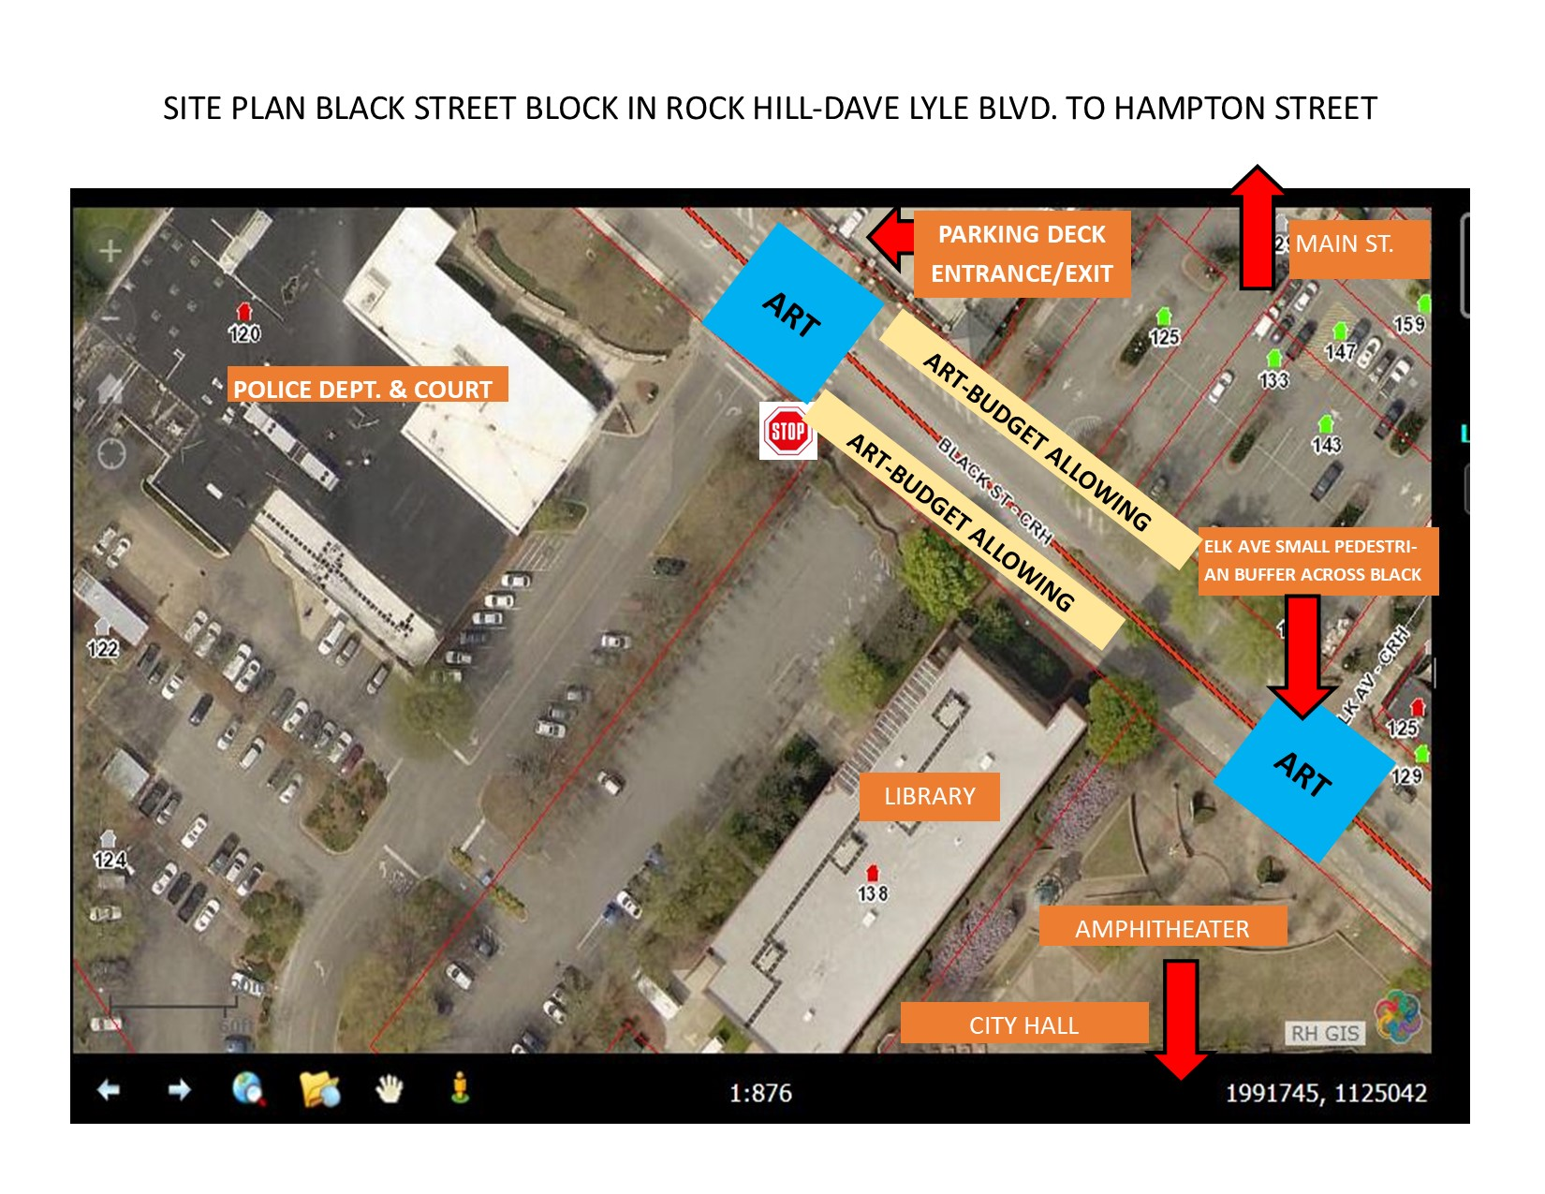

Slide 23
Project Timeline:
October 2021-Begin Coordination and Artist Selection Process
May-June 2022-Paint/install asphalt art. Document the process

Slide 24


Project Examples:

Slide 25
Freedom Riders Project in Rock Hill
The RHEDC QOL Committee has pledged their support to a 2022 project (TBD) to commemorate the arrival of the Freedom Riders in Rock Hill 60 years ago.
The Freedom Riders were a group of (initially) 13 Black and White individuals who set out in May 1961 to challenge the segregated buses and terminals of the American South.
Per federal law, segregated buses and terminals were illegal. However, the law was not being enforced.
The Freedom Rides were organized by the Congress of Racial Equality, led by Mr. James Farmer, who was also one of the Freedom Riders.

Slide 26
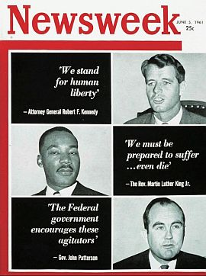
Freedom Riders Project in Rock Hill
May 9, 1961, The First Day of Violence
The Freedom Riders brought national and international attention to the South’s segregated society, shattering the complacency and go-slow attitudes of national leaders.

Slide 27
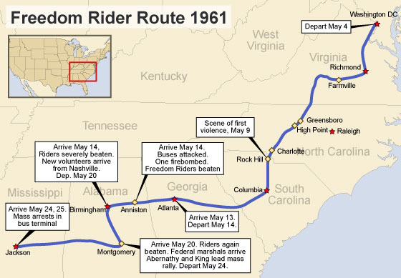

Slide 28
Six Community groups supporting the effort:
RHEDC QOL Committee
African American Cultural Resources Advisory Committee
Freedom Walkway Committee
Historic Rock Hill
Visit York County
Community Relations Council

Slide 29
Please lend your support:
On May 10th, 2021at 5:30pm, Gladys Robinson, representing the African American Cultural Resources Advisory Committee, and Chip Hutchison, representing Historic Rock Hill, will address City Council regarding an effort to honor and interpret the Freedom Riders' May 9, 1961 visit to Rock Hill.

Slide 30
Talent Development
Committee
Ron Roveri
Committee Chair

Slide 31
Adjourn
V. Other Business
Reminders
Upcoming Events | Date | Time | Place
Monthly Board Meeting | Tuesday, June 1, 2021 | TBD | TBD

