Slide 1
Rock Hill Economic
Development Corporation
Board of Directors
Monthly Meeting
Tuesday
November 1, 2021
12 noon via Zoom

Slide 2
AGENDA
Mission: To benefit Rock Hill economically by fostering increased employment opportunities and by expansion of business and industry; thereby, lessening the burdens of government and combatting community deterioration.
Call to Order and Welcome
Approve Minutes of the October 5,2021 Monthly Meeting
Reports/Project Updates

Slide 3
Industrial Development
Rick Norwood

Slide 4
Industrial Development Summary
NEW & On-Going Projects
  Soutwood – Aspen on schedule - walls and roof competed (73 jobs $6.5M)
  3D Systems – Waterford – expansion underway (50 Jobs, $13M)
  TAG.AERO – Waterford – interior upfit underway
  American Fiberglass Southway – under construction
  Site I TechPark Under Contract – ITS
  Site B TechPark Under Contract – Silverlining Investments
Prospect Activity
  11 Prospects – 2008 potential jobs, $357 million in capital investment.
  Rock Hill Commerce Center – (497 SF + 294SF) multiple prospects
  1800 Overview Drive – multiple prospects
  Legacy East (800SF + 200SF Spec planned for 2022)
  Aspen – Interest in Building B
  Waterford Flex property under contract (25 acres adjoining Waterford)

Slide 5
Finance
Committee
Matt Dosch

Slide 6
RHEDC
Statement of Activities
Budget
vs
Actual
as of
8/31/2021

Slide 7
RHEDC Statement of Financial Position
Previous Month Comparison
As of August 31, 2021
Emailed to the Board 10/5/2021
Finance Committee reviewed at September 30th meeting
Key Items:
Activities & transactions related to Talent Pipeline - With Uway grant funding assisted four businesses in paying a total of seven interns.
Activities & transactions related to Tech Incubator - With Relentless Challenge 2020 Grant funding assisted Gravity Center in paying for VMS Coordinator.

Slide 8
Entrepreneurship
Dan Ballou

Slide 9

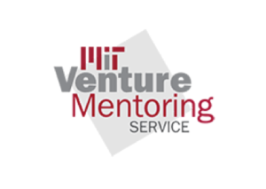


Slide 10

VMS
22 Mentors
19 Ventures
1 venture interview (Friday)
2 scheduled meetings in October
Monthly Mentor Meeting Oct 27th
Traction5 Pilot
Training (Executive Immersion) proposal
Outreach/Marketing
Office Hours development

Slide 11

Gravity Center Updates
LaunchPad, Tomorrow @8am
InBIA Entrepreneurship Center Management Certification
Co-working space
Global Entrepreneur Week (Nov 15)
Strategic Planning RFP
Partner meetings (ATC, Winthrop, Chamber, CLT Alliance, Dept of Commerce, SCBIA, Catawba COG
Processes, CRM, Building Improvements
Marketing/Media

Slide 12
Talent Development
Ron Roveri

Slide 13
Talent Development Committee
Focus Industries
Advanced Manufacturing
Information Technology
Hospitality & Tourism

Slide 14
Talent Development Committee
Goals:
Establish a landscape of all workforce and talent development initiatives within the City
Design, manage, and facilitate a shared network of data between the participating workforce parties
Improve and expand the talent pipeline program
Needs:
More representation from for-profit/industry partners (ie. HR directors/managers, Operations managers, etc.)
Ways to Engage:
Committee Member - Attends monthly meetings and provides insight & receives communications.
Committee Partner - Attends committee meetings quarterly for major updates & receives communications.
Interested Party - Receives information, resources, and events related to workforce and talent development.

Slide 15
Quality of Life
Melanie Jones

Slide 16
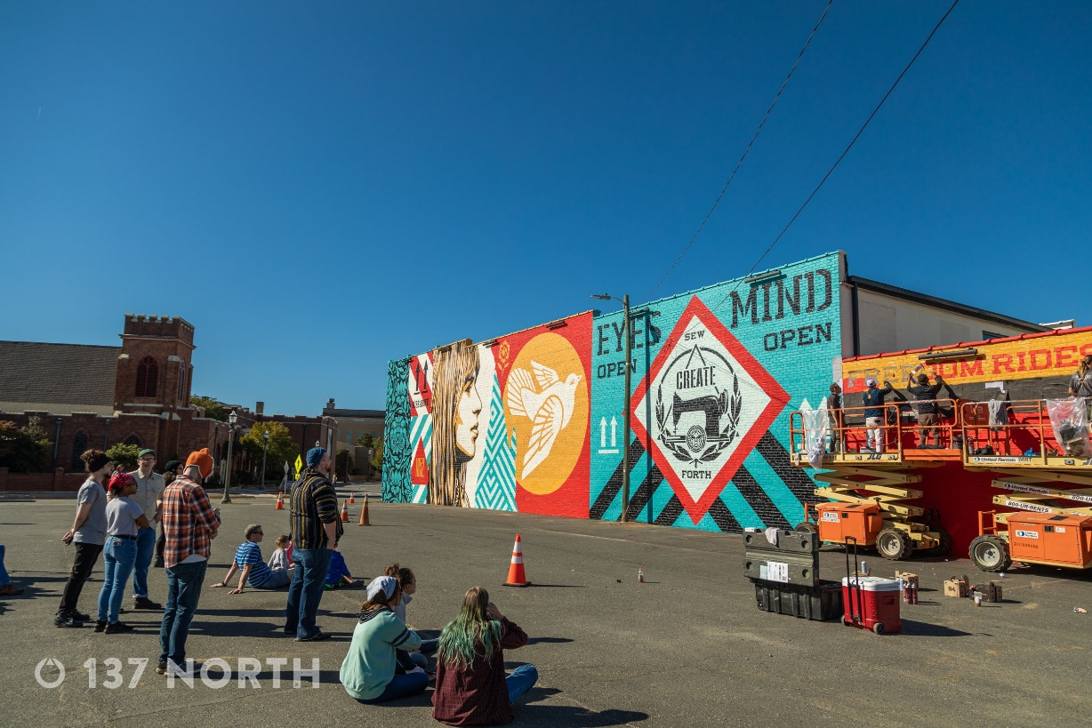

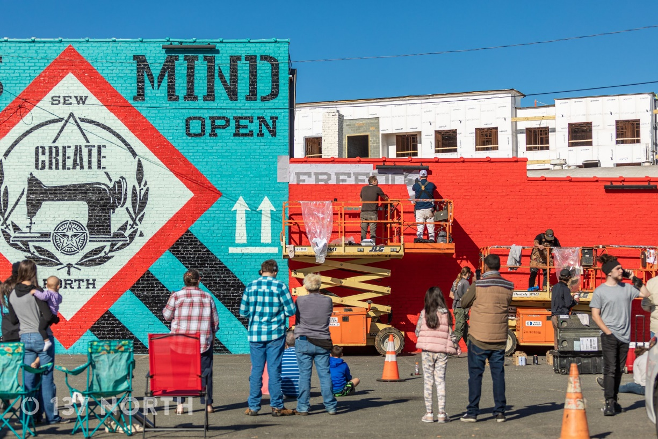
10-19-21 Shepard Fairey Mural completed
1 out of 110 SF murals worldwide
Rock Hill Coverage from at least 12 media outlets
Thank you to the RHEDC Barre Mitchell Fund, Catalyst Capital Partners, and the Women’s Art Initiative
A special thank you to our RH citizens who helped make Shepard & and his crew feel so welcome.
Thank you 137 North for the photos

Slide 17
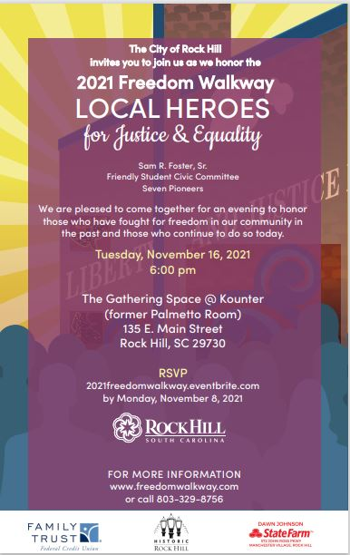



https://www.eventbrite.com/e/2021-freedom-walkway-celebration-tickets-170316123109
Thank you
2021 event sponsors:

Slide 18

The Barre Mitchell Community Initiatives Fund provides financial support for projects that enhance quality of life and support significant economic development goals in Rock Hill
Our goal is 100% Board participation! And $10,000
Projects RHEDC has supported to date:
  Freedom Walkway
  Knowledge Park Roundabout
  Bleachery Interpretive Plan
  Elk Avenue Art Project
 | 2015 | 2016 | 2017 | 2018 | 2019 | 2020 | 2021
Goal | $7,500 | $7,500 | $7,500 | $7,500 | $7500 | $7500 | $10,000
Raised to Date | $7,500 | $7,500 | $6,055 | $6,650 | $6100 | $1300 | $2300
Current Fund Balance: $15,585.73
Planned Expenditures in 2021:
Shepard Fairey Mural: $7000
Bleachery Heritage Project: $7035.73 Remaining balance $1550.00

Slide 19
Contribution form and the link below will again be emailed to Board after this meeting https://www.rockhillusa.com/about https://www.onlyinoldtown.com/barremitchell
2021 Goal: 100% Board participation $10,000 in contributions. Raised to date: $2300-up from $750 in October
Upcoming projects that will require funding:
Continuation of Mural Mile
Third project with WAI
2 projects on the South side-Clinton ConNEXTion

Slide 20
Other Business
David Swenson, York County Economic Development

Slide 21
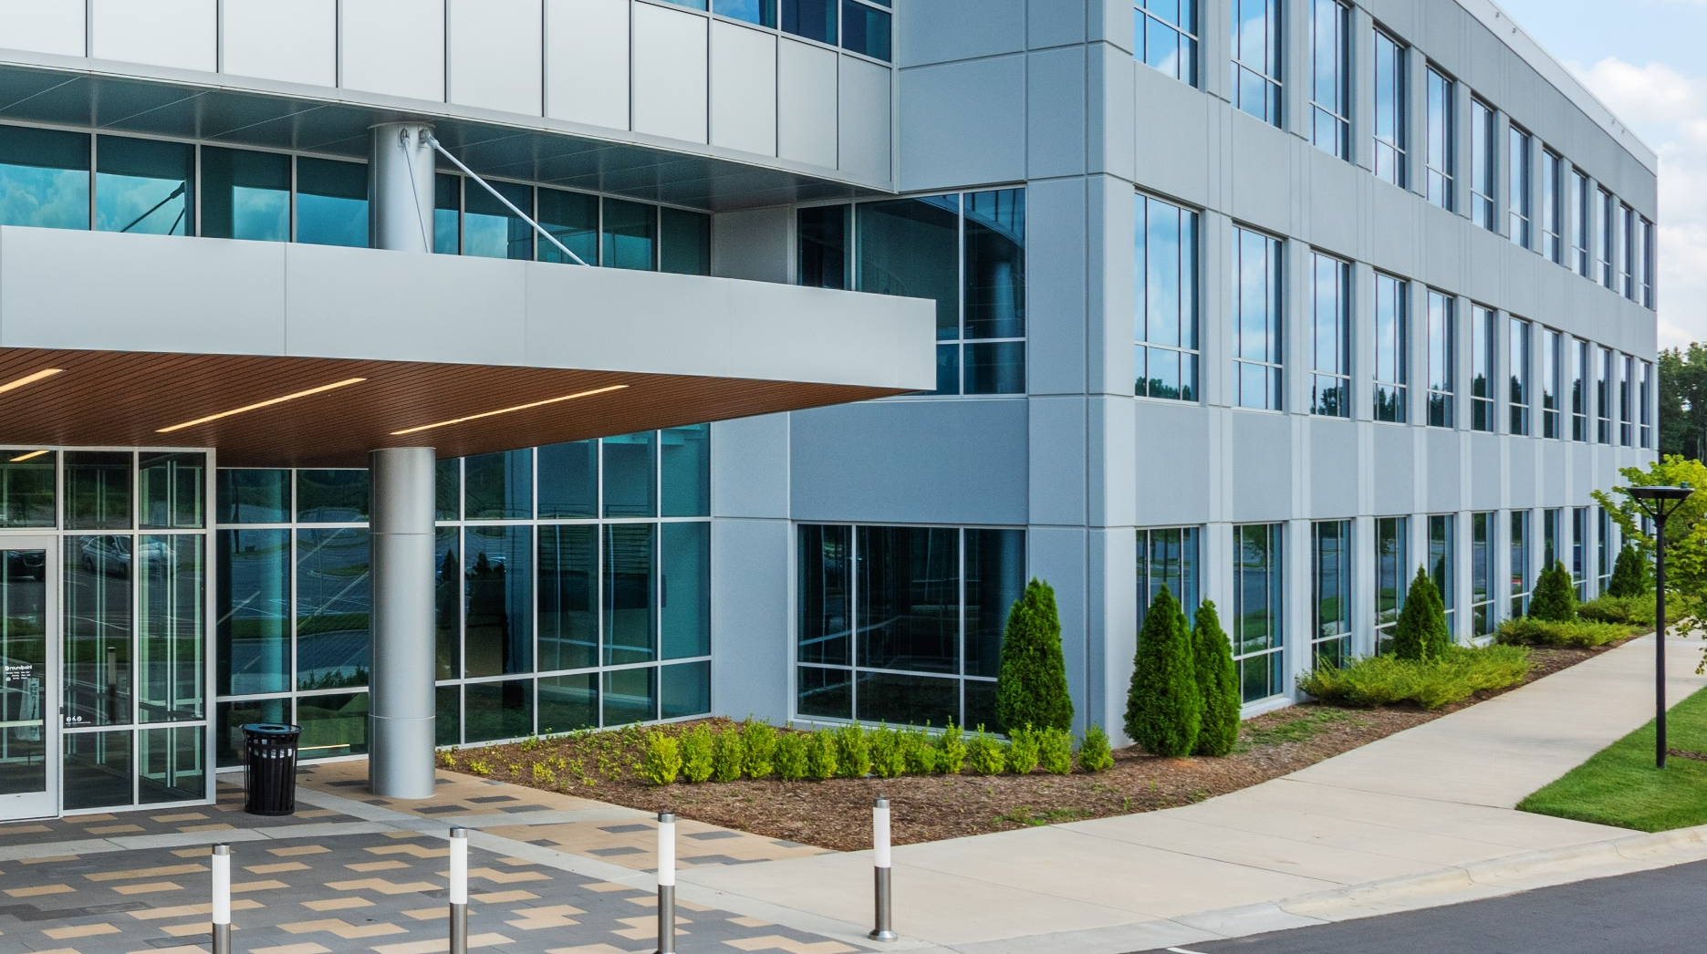


YORK COUNTY
FUTURE:
A Bold, High-performing
Economic Development Action Plan Designed To Achieve Success
Prepared for:
July 27, 2021
715 Birkdale Drive | Atlanta, GA 30215 | p 770.716.9544 | info@garnereconomics.com

Slide 22


Project Process
Site Visit
Assets & Challenges Assessment
Discovery Analysis
Confirm & Refine Target Business Sectors
Demographic, Economic, Labor, and Community Indicators
Benchmarking
Strategy Recommendations to achieve success
Community
Engagement
Business Sector Analysis
Strategy & Recommendations
Discovery
Analysis
YORK COUNTY Competitive Realities Report
YORK COUNTY FUTURE:
A Bold, High-Performing
Economic Development Action Plan Designed to Achieve Success

Slide 23

Key Findings

Slide 24

Stakeholder Engagement
Continued strong business climate
212
Total
Stakeholder Contacts
County Council Interviews
135
E-Survey
Responses
5
Focus
Groups
3.5
Overall Business Climate Rating

Slide 25



What Stakeholders Think
Survey respondents believe the following:
Similar perceptions of assets, inhibitors & infrastructure needs | Advantageous proximity to Charlotte Concern over transportation & desire for mass transit Internet infrastructure lacking in some areas
Workforce Concerns | Lacking soft skills/life skills Need for more technically skilled workers Competition with Charlotte employers
Quality of Place | Excellent schools & quality of life Divided assets in eastern and western parts of County

Slide 26
Economic & Community Assessment
Sample of ratings
Positive Ratings
Population
Age
Diversity
Migration
Educational Attainment
17
Graduation Rates
ACT Scores
Household Income
Per Capita Income
Poverty
Neutral Ratings
9
Cost of Living
Crime Rate
Air Service
Broadband
Negative Ratings
0

Slide 27

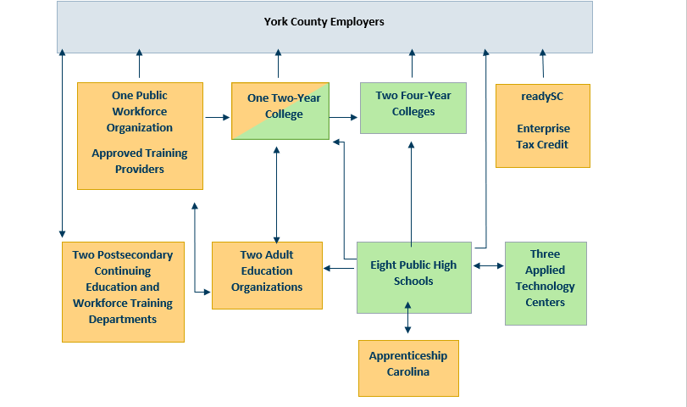
Execute Effectively – Workforce Development
York County Employers
Notes:
1. Incentives are a tool for governments to use to induce business investment. Done effectively, incentives can show a significant ROI for a local government. Done poorly, incentives can be a waste of public taxpayer money.
2. in the stakeholder engagement process of both focus groups with employers (the end customer) and in an eSurvey we conducted of businesses in the County, the feedback received was that more coordination and communication are needed to effectively execute the workforce service delivery system. Feedback from many was that the workforce group(s) that were used for either training, or finding talent, or both—whether it was a community college, technical school, readySC, or a four-year college, was mostly effective. Getting to the point of finding the right entity or conduit to help businesses was the issue. This new workforce council will bring workforce partners together with representatives from the business community in order to coordinate and maximize communication and workforce development programming. This new initiative may require a new talent development coordinator within the YCED or some other support partner,e.g. Chamber.
3. A community visit or learning lab is a trip to another city/county or region taken by a diverse delegation of leaders from a community’s public, private, and nonprofit sectors to learn about broad issues related to economic development. These visits are typically led and facilitated by a community’s chamber of commerce. In this case, we are suggesting the YCED lead the first and include the appropriate partners that can help facilitate economic growth in the county.
4. The YCED has a 2021 budget of $913,000. This is composed of $808,000 from the County and $105,000 from York County Growth Partners, a private sector group used to supplement the County’s economic development budget. On the surface, it would seem that an overall organizational budget for economic development at $913K is generous and well-funded. But this budget includes six full time staff and a significant amount of overhead related to the successful operations of the department. The program budget related to marketing and promotion totals $68,000, which is low if policymakers desire the YCED to be a more proactive business development organization rather than a successfully well-managed reactive organization. The current arrangement between York County Growth Partners and the County is for the private sector (Growth Partners) to fund a significant share of the marketing efforts. A more effective, proactive budget would equate to an additional $100,000 annually. This would allow the YCED to accomplish these tasks we outlined in the Communicate section of these recommendations, effectively and proactively.
5. Because the YCED accepts more than $100,000 a year from the private sector to supplement its budget, there is a necessity to have a governing board that represents both the public and private sectors. If no private money was received by the YCED, there would be no need to have any kind of oversight board since the county manager and ultimately the County Council have that responsibility.

Slide 28
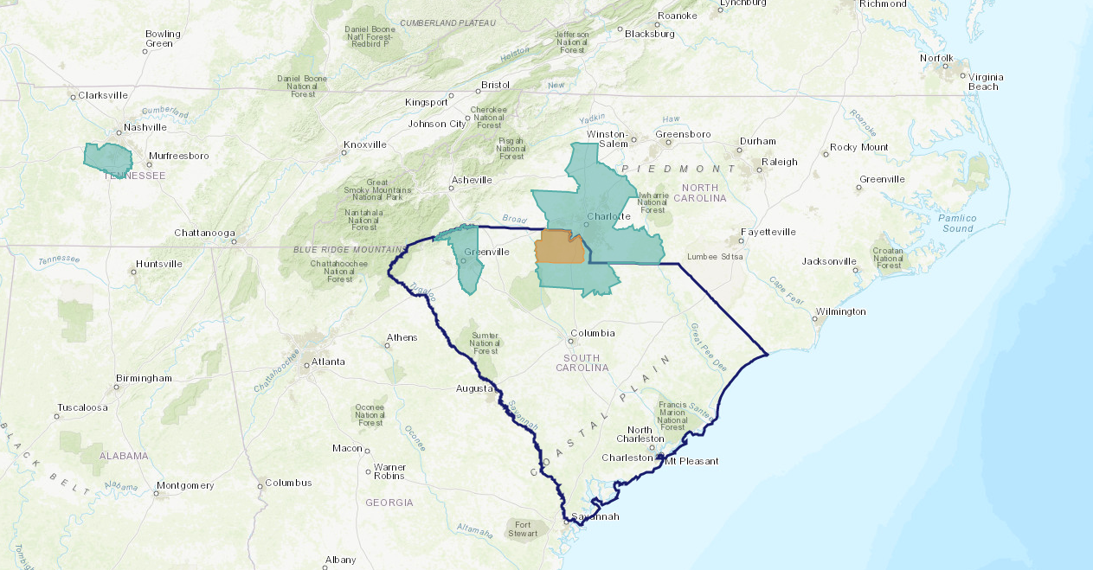
Benchmarking
Williamson County TN
Charlotte Metro
Greenville County
YORK COUNTY
Notes:
Benchmarks selected by the EDC.

Slide 29
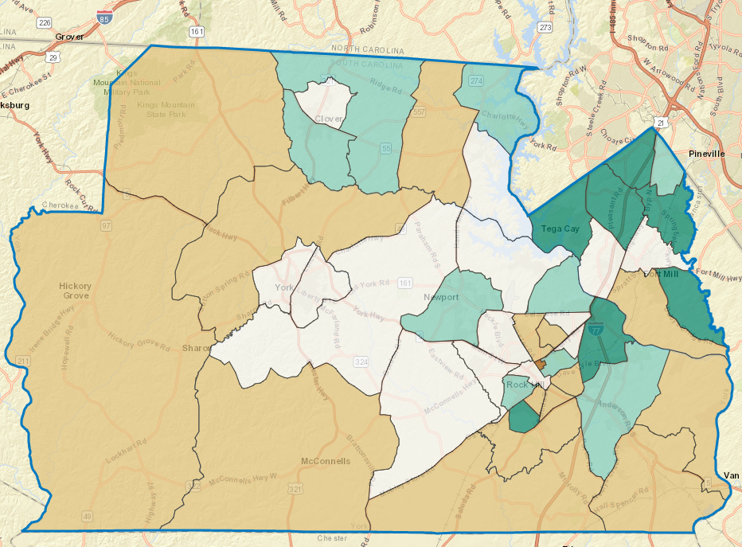
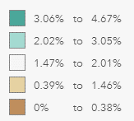
York County Estimated Annual Growth Rate
2020–2025
Source: ESRI

Slide 30
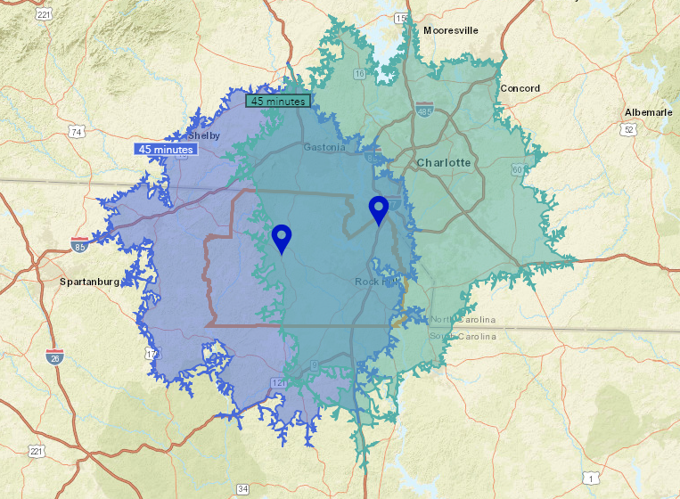
Labor Draw
818,406
Population
418,973
Labor Force
38.7
Median Age
Drive-Time from York 2019 Data
Source: ESRI
2,093,491
Population
1,125,810
Labor Force
37
Median Age
Drive-Time from Ft Mill
2019 Data
Source: ESRI

Slide 31
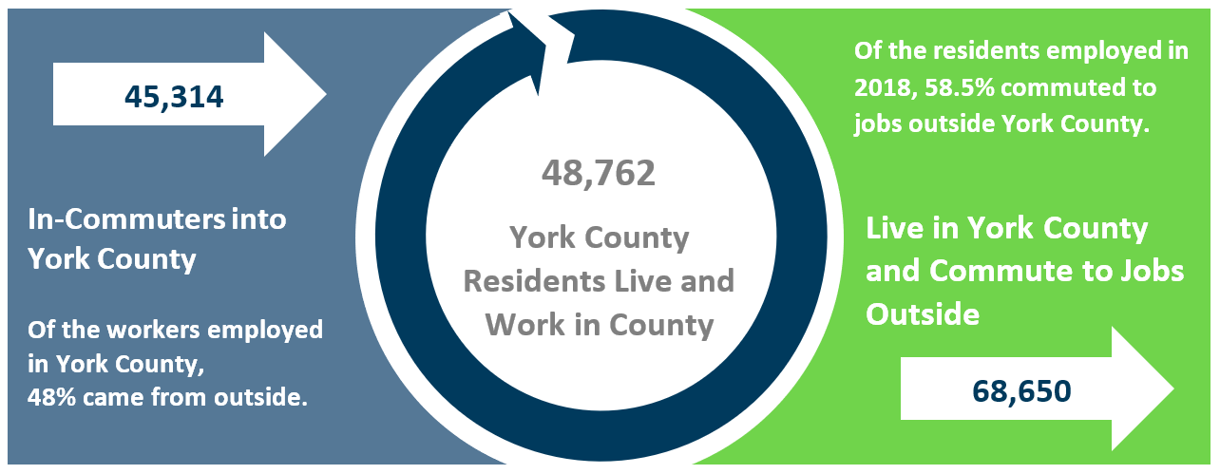
Commuting Patterns: Uneven Exchange
In 2018, 48% of employment base commuted into York County.
In 2018, 58.5% of residents commuted out of York County.
Source: US Census, Garner Economics
Notes:
12,500 from Mecklenburg and 35,483 to Mecklenburg

Slide 32
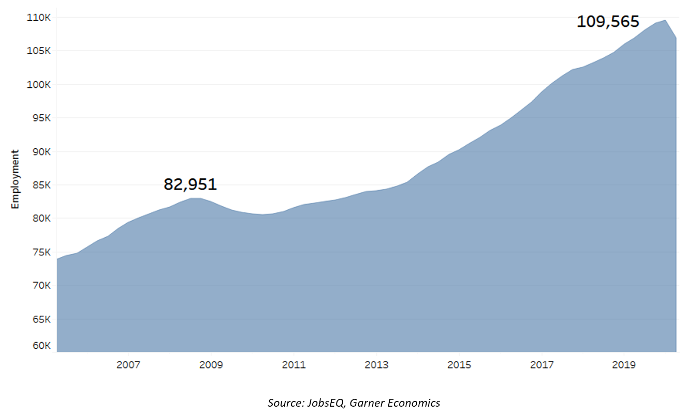
Job Growth
+15,793
New Jobs in York County
(5-Year Change, 2020)

Slide 33
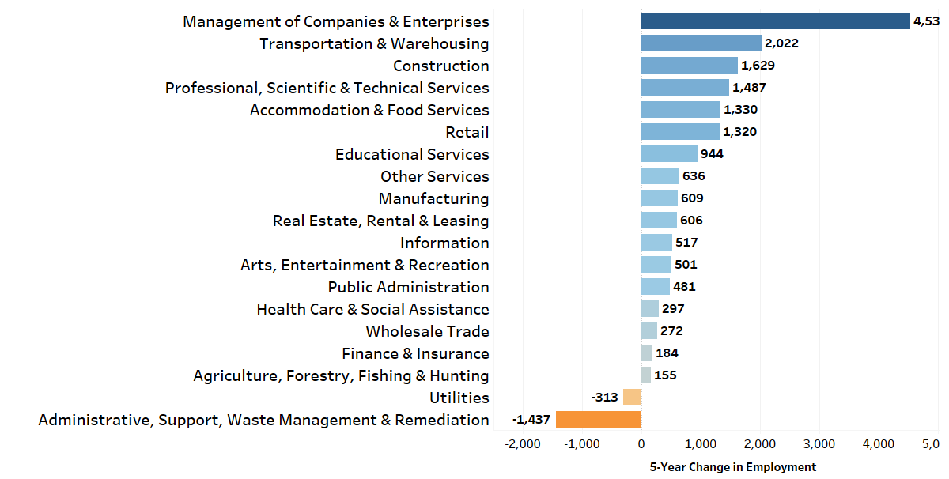
Five-Year Industry Change
Source: JobsEQ, Garner Economics (Job change greater than 100)

Slide 34
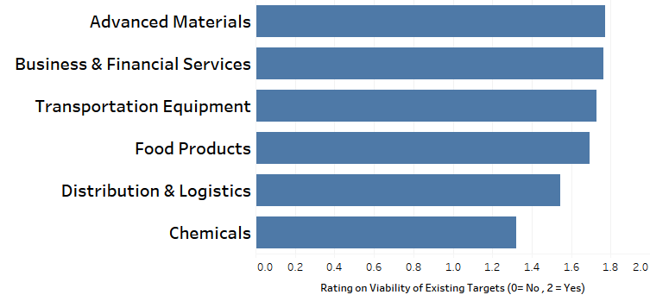
Refining York County Targets
Do the current business targets still make sense for York County?
Most survey respondents agree that current business targets still make sense
Validated current targets and worked to refine and develop target families that best serve the County’s current assets, tools, and marketing strategy
Desirability
Optimal
Targets
Feasibility
Source: Focus group feedback, Garner Economics
Notes:
County is successful and fairly diversified

Slide 35





Optimal York County Targets
Distribution facilities will locate to York County organically
CORE BUSINESS TARGET FAMILIES
Made in York County
      Made in York County
      Innovative Manufacturing
        Agribusiness
        Agriculture, Food & Beverage
      Imagined in York County
      Knowledge Sector
      Experience York County
      Experiential & Quality of Place
Imagined in
York County
Agribusiness
Experience York County
While target marketing is primarily the work of economic development, the execution of the quality of place target would typically be led by organizations other than the YCED.

Slide 36
Optimal York County Targets
RATIONALE & PRIORITY METHODOLOGY
Each target profile in the final report has rationale outlining the assets and opportunity for the target families
Specific subsector targets were ranked based on an index developed which used historical and forecasted job changes and historic change of gross product for subsectors in the nation and York County where available
Each sector’s top occupations were compared to the County’s living wage as calculated by MIT for 2-income family of 4.
Made in York County
Imagined in
York County
Agribusiness
Experience York County

Slide 37

Made in York County
Innovative Manufacturing
10-Year Historic Growth
National York County
Jobs = 7.5% Jobs =20%
GDP = 43% GDP =136%
Average Wage
Top cluster occupations: $22.27
York County Living Wage: $20.63
A workforce that knows how to manufacture
11,200 mfg employees, 97,000 within 45-minute commute
Areas of specialty and priority within target family include:
  Advanced materials
  Automotive & aviation components
  Packaging
  Pharmaceutical and medical equipment

Slide 38

Agribusiness
Agriculture, Food & Beverage Processing
Strong stakeholder feedback for agribusiness
York County entities sold > $100 million in agricultural products in 2017 (a 4% increase since 2012)
Areas of specialty and priority within target family include:
  Specialty foods (sauces, flavorings, etc.)
  Animal food
  Bakeries & tortillas
  Greenhouse & floriculture
10-Year Historic Growth
National York County
Jobs = 19.5% Jobs =-19%
GDP = 21% GDP = 64%
Average Wage
Top cluster occupations: $18.73
York County Living Wage: $20.63

Slide 39

Imagined in York County
Knowledge Sector
Highly educated population with 10,000+ graduates earning relatable degrees in region
Proximity to Charlotte & CLT airport
Areas of specialty and priority within target family include:
  HQ & professional services
  IT/Data & Analytics
  Fintech/Insurtech
10-Year Historic Growth
National York County
Jobs = 24% Jobs = 190%
GDP = 80% GDP = 171%
Average Wage
Top cluster occupations: $32.03
York County Living Wage: $20.63
The limited supply of Class A and Class B office buildings and high-speed internet in some areas of the County are challenges for this target.

Slide 40

Experience York County
Experiential & Quality of Place
Strong assets in education, cost of living but enhancing quality of place is essential for attracting businesses AND talent
York County is becoming known for sports
  BMX Supercross track, tournaments, Panthers
Building on this momentum by developing areas of expertise and attracting sports retail, sports medicine, and other sport-related experiences
Subsectors include:
1. Sports medicine 2. Breweries 3. Specialty retailers 4. Sports retailers

Slide 41

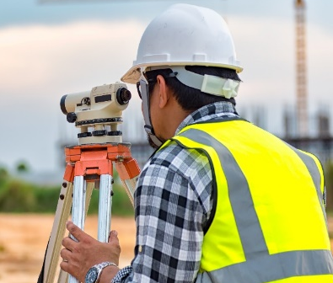


Recommendations to Continue Success
Execute
Effectively
Asset Development
Product improvement initiatives to ensure York can compete to attract, retain, and grow the types of companies and talent the community desires
Communicate the Brand
Marketing approaches for the YCEDD to share the economic dynamism of the County with target prospects and talent.
Execute Effectively
Organizational adjustments that allow the County to work proactively in those areas that will directly impact the economic growth the community desires.
Strengthen
the
Product
Tell the
Story

Slide 42
Recommendations for Next Steps
2021 – 2022 Fiscal Year
1. Modify the governance structure of the YCED with an advisory board appointed by the County Council and York County Growth Partners.
- Recommend modifying County ED Board Ordinance to address new structure that would go from 18 to 13 board members.
- Public Sector: 8
- 3 members of the York County ED Committee of Council
- 5 appointments representing mfg, service, real estate, financial services industry sectors
- Private Sector: 3
- YCGP recommend three from their membership for approval by Council
- Education / Workforce Development: 2
- President of Winthrop and President of York Tech (or designee)
- Ex-Officio: County Manager, York County Regional Chamber President (or designee)
2. Enhance and update the County’s incentive guidelines.
3. Develop a collaborative product development plan with public and private stakeholders.
4. Create an infrastructure, land use, and funding plan to provide W/S utilities to targeted areas of County.
5. Communicate regularly with the County Council on all things economic development

Slide 43
Recommendations for Next Steps
Years 2023 and Beyond
1. Establish a public/private workforce council to help fill the talent pipeline
2. Conduct economic and community development leadership learning labs in other inspirational communities
- Greenville, SC
- Williamson County, TN
- Mecklenburg / Charlotte, NC
3. Consider additional funding to support marketing, product development, and related items as identified in the strategic plan
4. Continue efforts to conduct external outreach to companies and consultants through existing regional marketing alliances and the South Carolina Department of Commerce.
5. Develop a stronger and more collaborative marketing effort to support common goals and messaging about York County as the place to do business.

Slide 44
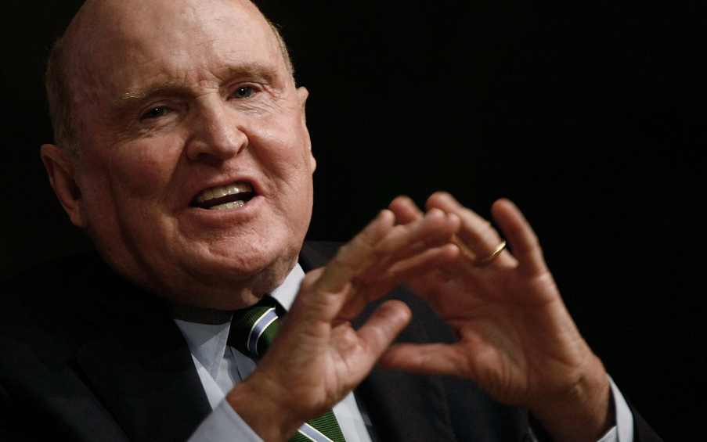
Sage Advice!
“Control your own destiny
or someone else will”
- Jack Welch

Slide 45
Adjourn
V. Other Business
Reminders
Upcoming Events | Date | Time | Place
Freedom Walkway Recognition | Tuesday, November 16, 2021 | 6PM | Gathering Space at Kounter
Monthly Board Meeting | Tuesday, December 7, 2021 | TBD | TBD

